Slide 1
SciELO SA criteria
17 February 2022
Louise van Heerden
SciELO SA Operations Manager

Slide 2
What is SciELO SA?
A method or technique that has been generally accepted as superior to any alternatives.
because it produces results that are superior to those achieved by other means
or because it has become a standard way of doing things and are used to maintain quality
and can be based on self-assessment or benchmarking. (Bogan & English, 1994)

Slide 3
What is SciELO SA?
Firstly SciELO stands for Scientific Electronic Library Online.
All SciELO journals are open access.
SciELO originated in Brazil and there are now national collections in 15 countries, that make up the SciELO Network of journals.

Slide 4
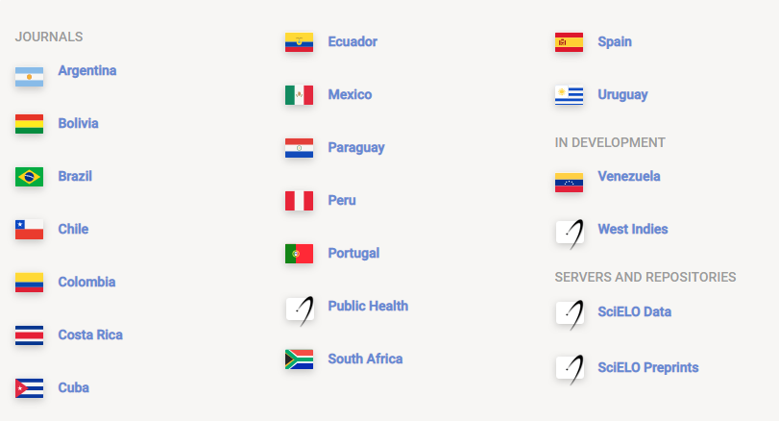
www.scielo.org

Slide 5
SciELO SA is a prestigious open-access (free to access), full-text searchable database of selected, high-quality South African scholarly journals.
SciELO SA focuses on strengthening the scholarly journal evaluation and accreditation systems in South Africa through wide dissemination of excellent SA research and by representing publishing best practice.

Slide 6
Why do journals want to be included in SciELO?
Strict standards and requirements
Well managed
Highly regarded index in the South
SciELO Citation Index forms part of the Clarivate Web of Knowledge search platform.

Slide 7
The SciELO SA collection was started in 2009 www.scielo.org.za SciELO SA currently includes 84 titles http://www.scielo.org.za/scielo.php?script=sci_alphabetic &lng=en&nrm=iso SciELO SA is managed by the Academy of Science of South Africa (ASSAf), funded by the SA Department of Science and Innovation (DSI) and endorsed / accredited by the SA Department of Higher Education & Training (DHET).

Slide 8
What editorial practices need to be in place to be included in SciELO - First be accredited to the Department of Higher Education and Training. - Then undergo a rigorous process of quality appraisal by an
ASSAf peer-review panel that evaluates the journal and the quality of the articles. - The panel investigates the reliability and credibility of the journal and if it offers innovative research by South Africa’s top researchers.
Be recommended for inclusion in SciELO SA by the evaluation panel.
Then the SciELO SA team checks if the journal adheres to the SciELO Network criteria.

Slide 9
Criteria for inclusion in (and remaining in) the SciELO SA collection:
https://sites.google.com/view/assaf-scholarly-pub-resources/scielo-sa/criteria-for-acceptance
For a journal to be invited to be included in the SciELO SA collection it needs to meet the following criteria:
The Journal needs to be a South African journal accredited by the SA Department of Higher Education and Training (DHET).
2. Have received a positive peer review evaluation and recommendation for inclusion in SciELO SA, from the relevant ASSAf Peer Review Panel.

Slide 10
Criteria for inclusion in (and remaining in) the SciELO SA collection:
Publish open accessibly, i.e., there is no cost for, or embargo on full-text articles and ASSAf may harvest the articles from the journal’s website for e-publication on the SciELO SA platform.
4. The journal needs to have its own website with an archive of the
the journal’s issues and articles.
5. The primary website of the journal needs to be open access.

Slide 11
Why open access?
Story of the mother of a family making a meal (**) at home, and then taking it to the next village and her own family gets none of it.
(Source: Abednego Corletey, Association of African Universities)
Research for journal articles (see ** above) is funded mainly by government.
But many of these articles are not freely available to South Africans because they are published in commercial journals / databases.

Slide 12
Criteria for inclusion in (and remaining in) the SciELO SA collection (cont)
6. Publish regularly, on time and throughout the year. Where a journal
publishes continuously at least three articles need to be sent to the
SciELO team by end-March, 3+ articles by the end of June, another
3 by the end of September and another 3 by mid-December.
7. Publish at least 10-12 original articles per year depending on the
subject area.
8. Assign Digital Object Identifiers (DOIs) to its original articles.
E.g.

Slide 13
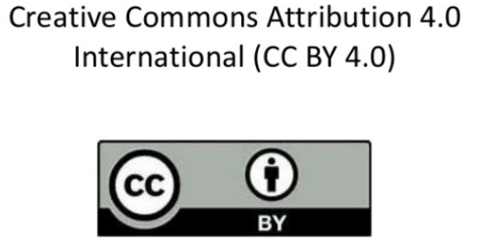
Criteria for inclusion in (and remaining in) the SciELO SA collection (cont)
9. All articles must include an English abstract and English keywords.
10. The affiliations and ORCIDs of authors need to be stated in the article.
11. State the journal’s Creative Commons license,
e.g., CC-BY 4.0, on the journal’s webpage
BY means that credit must be given to the creator.
Share — copy and redistribute the material in any medium or format
Adapt — remix, transform, and build upon the material for any purpose.

Slide 14
Criteria for inclusion in (and remaining in) the SciELO SA collection (cont)
12. Sign a Publisher’s Agreement with ASSAf.
13. Provide proof of applying for inclusion in the Directory of Open Access Journals (DOAJ).

Slide 15
Thank you
Louise@assaf.org.za

