Slide 1
Open Journal Systems: Best Practices and Use Cases
25 March 2025

Slide 2
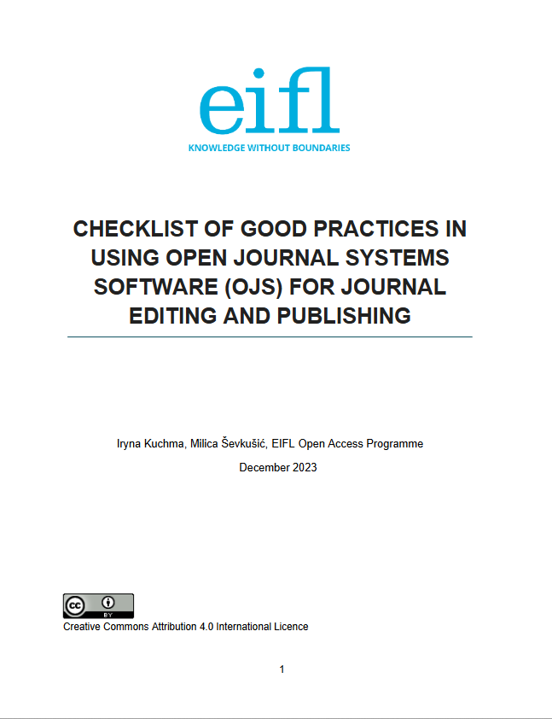
Open Journal Systems
Created and managed by Public Knowledge Project (PKP), non-profit research initiative
First released in 2001
GNU General Public License
Website: https://pkp.sfu.ca/software/ojs/
Technical documentation: https://docs.pkp.sfu.ca/dev/
More than 50,000 journals worldwide use OJS
Kuchma, I., & Ševkušić, M. (2023). Checklist of good practices in using Open Journal Systems software (OJS) for journal editing and publishing (Version 3). Zenodo. https://doi.org/10.5281/zenodo.10665389
Khanna, Saurabh, Jonas Raoni, Alec Smecher, Juan Pablo Alperin, Jon Ball, and John Willinsky. 2024. ‘Details of Publications Using Software by the Public Knowledge Project’. Harvard Dataverse. https://doi.org/10.7910/DVN/OCZNVY.

Slide 3
EIFL webinar series
Why?
OJS is widely used free and open-source software (FOSS)
Interesting new developments technical improvements, alignment with best publishing practices, better interoperability with other FOSS software solutions and scholarly infrastructures, and more
Huge community interest and growing needs
Our focus
Use cases, best practice and experience sharing
Practical advice
Recommending specific tools
Handling challenges
Community and networking
Let’s compile a directory of useful OJS tools and plugins: OJS tools and plugins.xlsx
If you want to present your use case, contact iryna.kuchma@eifl.net or milica.sevkusic@eifl.net

Slide 4
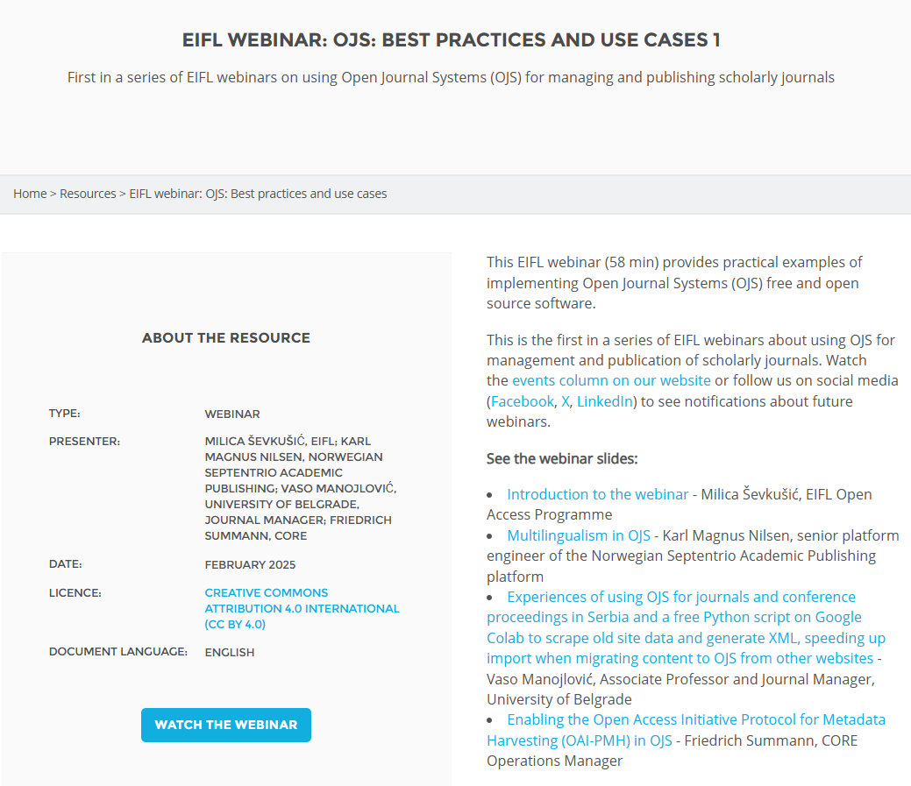
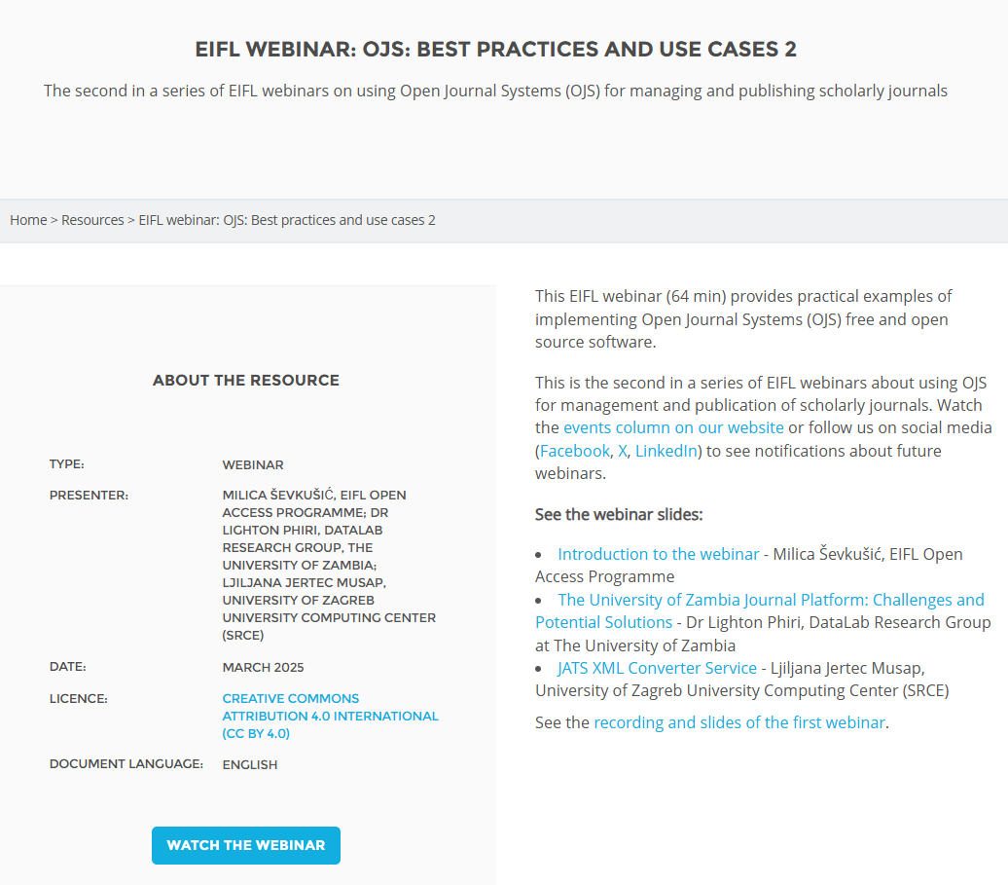
Previous webinars
https://eifl.net/resources/eifl-webinar-ojs-best-practices-and-use-cases-1
https://eifl.net/resources/eifl-webinar-ojs-best-practices-and-use-cases-2

Slide 5
Coming next
Increasing visibility of OA journal content with OJS and DOAJ
Date and time: 23 April 2025, 12:00 UTC
To register: You can register here: https://us02web.zoom.us/webinar/register/WN_HXEMiZq_QL20Gbhd-bmnHA#/registration
Presenters:
Dominic Mitchell, Deputy Director and Platform Manager at DOAJ
Mariya Maistrovskaya, Senior Publication Support Specialist at PKP

Slide 6
Agenda
Khulisa Journals platform (Ina Smith, Planning Manager Scholarly Publishing Programme, Academy of Science of South Africa (ASSAf)
The use of OJS in Lithuanian journals (Vincas Grigas, President of the the Association of Lithuanian Serials)

