Slide 1


JOURNAL OF KENYA ASSOCIATION OF PHYSICIANS (JOKAP): RESULTS OF AUTHOR TRAINING
Dr Bundi Karau
Managing Editor, Jokap

Slide 2
Milestones we have achieved in 2024/2026

Slide 3
1. Editorial Team
Development Editor, interns, and assistant recruited
2. Website & Platform
OJS submission system introduced
Updated journal policy, editorial team page, about, social media, subscription
Author guidelines, copyright policy, funding details, archiving
OJS updated
3. Production & DOI
DOIs assigned for issues (via AJOL)
Galley proof template structured
Issues released (March and Sept)- timely, quality papers.

Slide 4
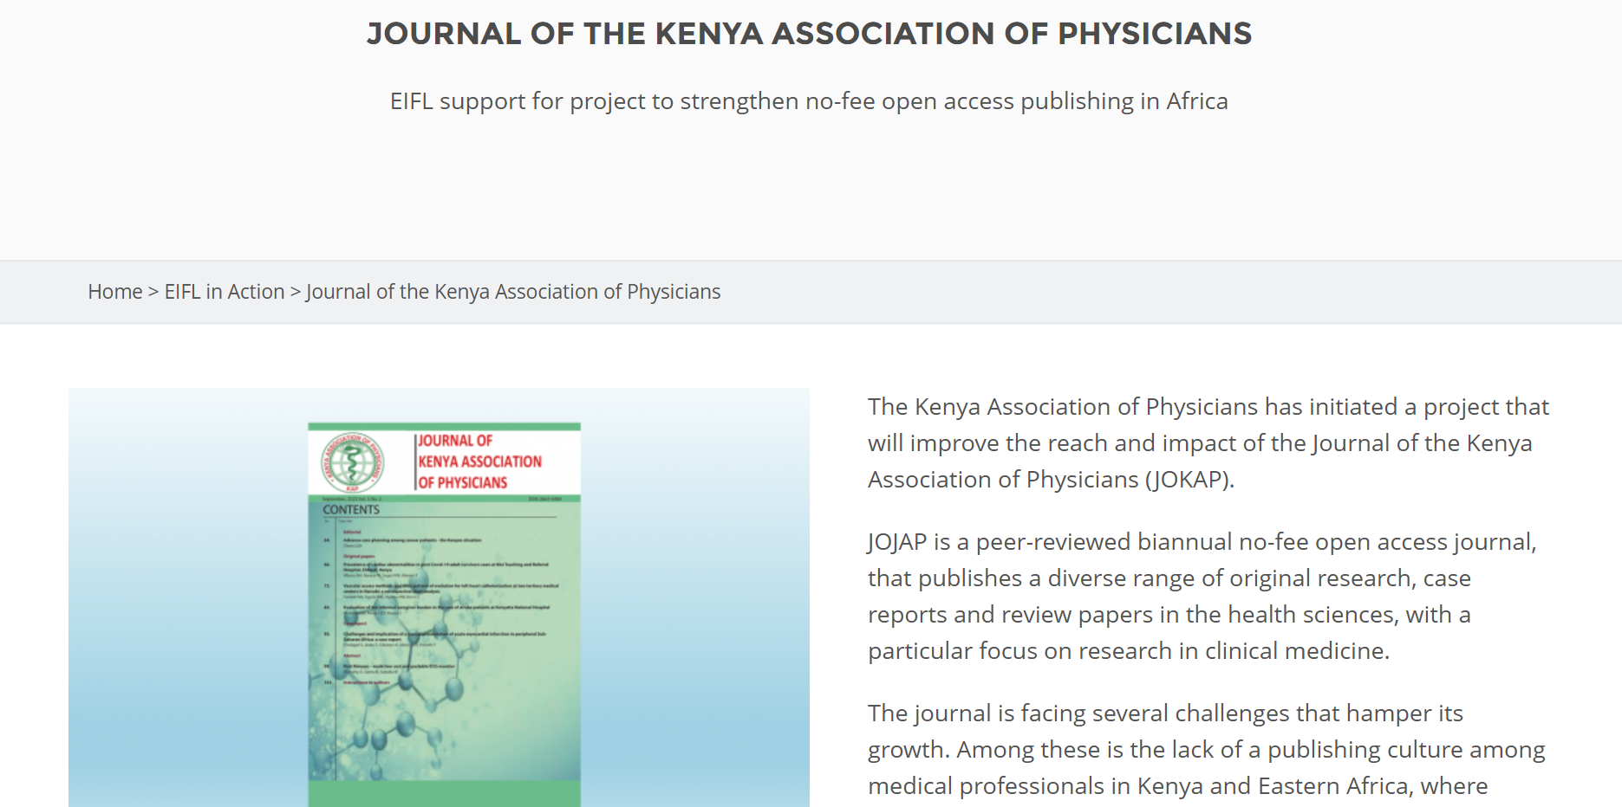
EIFL Open Access Funding
JOKAP was one of 17 projects that have received grant support through a three-year project to strengthen no-fee open access publishing in Africa implemented by EIFL, AJOL (African Journals Online) and WACREN (the West and Central African Research and Education Network), with funding from Wellcome.

Slide 5
Progress made under the EIFL Grant
Reviewer and Editor Training conducted at Saturday, 15th March 2025 at Pride Inn Boutique Hotel, Westlands-Nairobi. 45 reviewers and editors and 15 speakers and facilitators engaged.
Enhanced quality of the website, online submission process, review and paper production
Increased journal visibility- Google, Google Scholar Account, LinkedIn, Instagram and all platforms
Timely communication with KAP/ECSACOP Members, including monthly article spotlights
Recruitment of over 200 reviewers- Jokap has a vibrant stand during the August Ecsacop/KAP Conference, and was able to attract reviewers from the region

Slide 6
Progress made under the EIFL Grant
Reviewer and Editor Training conducted at Saturday, 15th March 2025 at Pride Inn Boutique Hotel, Westlands-Nairobi. 45 reviewers and editors and 15 speakers and facilitators engaged.
Enhanced quality of the website, online submission process, review and paper production
Increased journal visibility- Google, Google Scholar Account, LinkedIn, Instagram and all platforms
Timely communication with KAP/ECSACOP Members, including monthly article spotlights
JOKAP is indexed in AJOL, DOAJ, ASCI & AR

Slide 7
The Author Training Program

Slide 8
Program Conceptualization
ECAJS–JOKAP Author Training Workshop. The workshop entailed a hands-on series designed to equip students, postgraduates, and early-career researchers in health and related fields with practical tools for impactful research and publishing. A total of 22 sessions were delivered over a period of 3 months each week having two sessions on Monday and Thursdays.
All sessions were recorded, edited and uploaded on YouTube for on-demand streaming through the JOKAP website accessible here alongside the topic outlines, learning objectives and assignments for each of the sessions: https://kapjournal.com/index.php/kap/en/authortraining
We leveraged new partnerships with the International Federation of Medical Students Association (IFMSA), Medical students Association of Kenya (MSAKE), Kenya Medical Laboratory Students Association (KEMELSA), XYZEDI MED, and Standing Committee on Research Exchange (SCORE). As a result, a total of 1,021 people signed up for the author training including medical students, registrars, physicians and surgical residents.

Slide 9
JOKAP and the East and Central African Journal of Surgery (ECAJS), with support from EIFL (Electronic Information for Libraries) and in partnership with the International Federation of Medical Students’ Associations, Medical Students’ Association of Kenya, The Kenya Medical Laboratory Students’ Association and Xyzedizedi, successfully conducted a CPD-accredited author training workshop from 28th July to 9th October, 2025.
This initiative, delivered via zoom, was designed to address the critical need for enhanced research writing and publication skills among early-career researchers, clinicians new to publishing, and students at undergraduate, graduate, and postgraduate levels.

Slide 10
Promotion of the workshop was conducted through student organizations and professional networks using WhatsApp, Instagram, X, and LinkedIn, as well as through partner student associations.
This dissemination strategy significantly increased visibility among students, particularly in Kenya, where partner organizations have strong membership bases.
As a result, undergraduate students from Kenyan universities formed the largest proportion of participants.
A total of 960 individuals registered for the program, demonstrating substantial demand for research capacity building in Kenya and across East Africa.

Slide 11
Training program
The workshop spanned eleven weeks and included 21 bi-weekly sessions of 90 minutes each at 1900 hrs EAT, targeting a diverse cohort of participants ranging from novice researchers to experienced authors seeking to refine their skills.
Sessions were facilitated by academics and journal editors, providing participants with both pan-African and international perspectives on research standards and publication practices.
The curriculum comprehensively covered the research process, including research conceptualization and design, literature review methodologies, data collection and analysis techniques, ethical considerations, manuscript preparation and structuring, journal selection and submission, peer review navigation, and publication ethics.
At the end of each session, participants were given assignments to do at their own time in order to promote hands-on learning.
The program successfully attracted a diverse cohort of participants, including early-career researchers, undergraduate, graduate, and postgraduate students, and even experienced authors seeking to refine their research and publishing skills.

Slide 12
Results
Variable | Category | Frequency (n) | Percentage (%)
Gender | Male | 508 | 52.9
 | Female | 452 | 47.1
Country of Residence | Kenya | 666 | 69.4
 | Zambia | 83 | 8.6
 | Ethiopia | 52 | 5.4
 | Others* | 159 | 16.6
Specialty / Level of Study | Undergraduate Medical Students | 575 | 59.9
 | Medical Officer Interns | 71 | 7.4
 | Medical Officers | 52 | 5.4
 | Consultants | 91 | 9.5
 | Others# | 171 | 17.8
Taken Part in Any Research Project | Yes | 496 | 51.7
 | No | 464 | 48.3
Ever Published Research Work | Yes | 162 | 16.9
 | No | 798 | 83.1
Level of Research Experience | None | 204 | 21.3
 | Beginner | 519 | 54.1
 | Intermediate | 219 | 22.8
 | Advanced | 16 | 1.7
 | Expert | 2 | 0.2

Slide 13
Impact of Author Training Workshop
Knowledge improvement was evident, with the pre-course assessment average score of 85.519/100 increasing to 95.826/100 post-course, representing an average improvement of 10.307 points, or a 12.1% increase.
Of the total participants, 194 (83.6%) demonstrated an increase in post-intervention scores (positive ranks), 29 (12.5%) showed a decrease (negative ranks), and 9 (3.9%) had no change (ties).
A Wilcoxon signed-rank test of pre and post-workshop scores showed a statistically significant difference between pre- and post-intervention scores (Z = −10.769, p < 0.001).

Slide 14
Participant Feedback
Post-course survey results reflected high participant satisfaction and perceived impact. Overall satisfaction averaged 4.6/5.0, with 95% of participants rating satisfaction as 4 or 5 out of 5 and 68% giving the maximum rating of 5.
Content relevance averaged 4.5/5.0, with 92% rating the content as relevant and 78% assigning the highest rating.
Facilitator quality received an average score of 4.7/5.0, with 97% rating facilitators highly and 73% giving maximum ratings for effectiveness.
Program organization and learning methods effectiveness averaged 4.5/5.0 and 4.4/5.0, respectively, and 98% of participants reported that the workshop met or partly met their expectations.
Participants reported acquiring a wide range of practical skills. Research methodology and design were reported by 89% of participants, data analysis skills using SPSS or Excel were acquired by 76%, with participants, manuscript writing and publication skills were gained by 82% of participants, and grant writing and funding application skills were reported by 71%.

Slide 15
Application intent
94% of participants reported they were “Very Likely” or “Likely” to apply the skills learned, with 72% indicating “Very Likely” for implementing knowledge gained.
Anticipated challenges included limited access to mentorship (45%), with participants commenting, “Finding the right mentor, getting call outs for research opportunities” and “Difficulty finding a mentor to start an actual project”; limited funding and resources (38%), with statements such as limited resources and gaps in practical experience (31%), illustrated by, “Translating theory into practice, moving from selecting a study design in theory to successfully implementing it” and “Experience but that should be fine.”

Slide 16
Long-term impact indicators
Immediate outcomes included
  improved confidence in research capabilities (98%)
  plans to initiate research projects within six months (94%), intentions to submit manuscripts within 12 months (87%)
  and pursuit of ongoing mentorship connections (76%).
In terms of professional development, participants earned CPD credits, enhanced their CVs for career advancement, built networks, and established a foundation for future collaborative research projects.
Collectively, these results reflect the workshop’s substantial contribution to strengthening research capacity in East Africa.

Slide 17
Conclusion
The JOKAP-ECAJS author training workshop represents a successful capacity-building initiative
Contributes to the growing body of evidence demonstrating that structured research training programs are effective in improving knowledge, confidence, and readiness to engage in research among early-career professionals in Africa.
However, consistent with existing literature, sustained impact on research productivity requires addressing broader systemic barriers.
A combined approach integrating training, mentorship, and institutional support is therefore essential for achieving meaningful and lasting improvements in research capacity across the region.

