Slide 1
How to get more content for your repository
Milica Ševkušić, EIFL
6 June 2024

Slide 2
Outline
Repository as infrastructure
Depositing in a repository: organization and workflows
Green open access and compliance with open access mandates: identifying the right version of a publication
Depositing content that is already OA
Beyond formal publications

Slide 3
Institutional repository
Infrastructure for archiving and dissemination
Motivation:
collecting research outputs relevant for research assessment;
Enabling compliance with OA mandates;
pooling together research outputs from earlier periods;
Enabling access to institutions’ publishing outputs (journal backfiles, books, etc.);
Archiving all sorts of materials relevant for the institution (posters, presentations, reports, etc.) - heritage aspect (more often OA than publications).
Yet another database
Preference for social networks
Motivation
Depositing outputs necessary for promotion;
Compliance with OA mandates
Creating a complete personal bibliography (not necessarily with full text and/or OA);
Increasing the visibility of outputs not indexed by citation indexes (esp. STEM);
Making print-only publications available online (esp. SSH);
INSTITUTIONS
RESEARCHERS
Notes:
Enabling access to institutions’ publishing outputs (journal backfiles, current and digitized books)
Archiving OTHER

Slide 4
Dissemination via repositories
OAI-PMH
REPOSITORY
HTML meta tags
web scraping

Slide 5
Challenges to institutional repositories
Poor usage
The lack of dedicated funding
The lack of staff
The lack of policies or poor policy implementation
Organizational issues

Slide 6
What to deposit?
Everything, but define priorities based on policy requirements.
Those versions of journal articles that can eventually be made OA (e.g. Author Accepted Manuscripts)
All outputs that are published in OA
Publications that are not OA and won’t be OA in the repository (to ensure that they are preserved and to make your institutional archive complete)
Any non-publication materials relevant for the institution (posters, factsheets, presentations, reports, research data, DMPs, etc.)

Slide 7
Who should deposit?
Librarians create better metadata but they don’t have access to all outputs or don’t know that a particular author has published something (authors would have to provide content)
Researchers have the content but some don’t follow instructions and submissions have to be heavily edited by repository managers or even returned to submitters.

Slide 8
Workflows
Getting the information
Communication with authors
Depositing
Set up alerts in search engines and indexing databases to get informed when a new publication with your affiliation is released. This will cover only a part of the output.
Upon receiving an alert contact the author(s) from your institution and ask them to provide the appropriate version of the publication or to deposit it in the repository.
Deposit the publication or check the submission made by the author.
Receive information from the CRIS system.
Ideally, be informed by researchers or get them to submit all outputs to the repository.
Contact the author(s) from your institution and ask them to provide the appropriate version of the publication or to deposit it in the repository.
Deposit the publication or check the submission made by the author.
Explaining what’s the right version of a publication may require additional effort.
It may be necessary to return (reject) the submission to the author to make corrections and provide the right version.
Integrate the repository into reporting workflows – e.g. the regular annual reports submitted by research groups are checked by the library to see whether all reported outputs are deposited in the repository and whether all OA versions are provided. Researchers are required to provide the missing items.

Slide 9
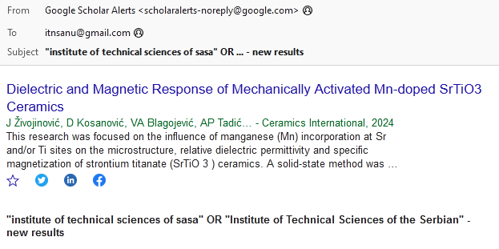
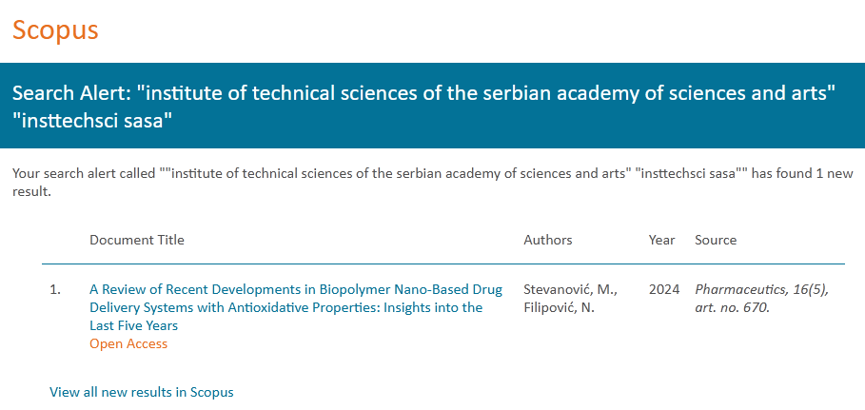
Alerts
Automated email notifications based on a saved search
Set up alerts in Google Scholar, Scopus, Web of Science or any other relevant databases

Slide 10
Access options for research outputs: general overview
Access at the publication venue | Deposited version | Access in the repository | Licence | Embargo
1. OA (Diamond, Gold Hybrid) | VoR | OA | The same as in the journal | None
2a. closed | VoR | closed/restricted | All rights reserved | N/A
2b. closed | AAM | OA Very often not possible for books and book chapters! | As defined in journal policy or funder/institutional policy | As defined in the journal policy or funder/institutional policy
3. Free to read, no OA policy, no licence Print only | VoR | If the authors haven’t transferred copyright - OA (often the case with conference objects) Otherwise, contact the publisher to ask/negotiate. If copyright is transferred to the publisher, archive VoR and negotiate with the publisher about depositing the AAM. | If the authors haven’t transferred copyright - apply the licence required by the policy or ask authors to choose. If copyright is transferred to the publisher, archive VoR and negotiate with the publisher about depositing the AAM. | No (if OA is possible) N/A As negotiated with the publisher

Slide 11
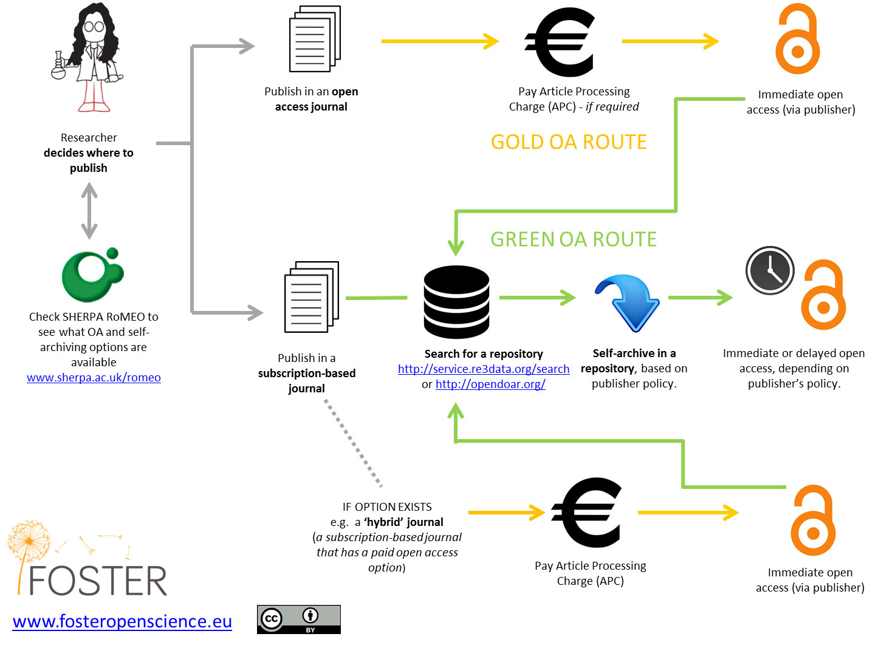

Slide 12
Versions
Submitted version Pre-print Author’s Original Version (AOV) | Original submitted manuscript, neither peer reviewed, nor typeset | It can normally be deposited in a repository without an embargo but this is usually not the ‘right’ version.
Author accepted manuscript (AMM) Accepted manuscript (AM) Post-print | Peer-reviewed accepted manuscript, not yet copyedited or typeset Examples: https://hdl.handle.net/21.15107/rcub_dais_9544 https://hdl.handle.net/21.15107/rcub_dais_10034 https://hdl.handle.net/21.15107/rcub_dais_4924 | In most cases it can be deposited in a repository; an embargo period is often involved.
Pre-proof | Looks the same as AAM with a front page, but it can’t be deposited (see next slide) | Can’t be deposited in a repository
Uncorrected proof | Peer-reviewed accepted and typeset article awaiting final proofreading | Can’t be deposited in a repository
Corrected proof | Peer-reviewed accepted, typeset and proofread article awaiting to be assigned to a volume/issue | Can’t be deposited in a repository
Published version of journal article / monograph or Version of Record (VoR) | Final published version, peer reviewed, copyedited, typeset, proofread and assigned to a volume/issue | In most cases, it can’t be deposited in a repository, unless the journal is OA or this is explicitly allowed by the self-archiving policy

Slide 13
The mystery of the pre-proof
“Prior to July 2019, the 'journal pre-proof' was referred to as ‘accepted manuscript’. Since then, the labeling of this version of the article was changed as it was confusing. These versions were not intended to be used for author self-archiving as they are not accepted manuscripts.
We understand the concern that we are perceived to be closing down a route to institutional archiving that previously existed. This was never our intention, as the journal pre-proof was never intended to support institutional archiving — it was a simply a way to surface findings before the final version was posted. We regret that our mislabeling has created this confusion.”
https://www.elsevier.com/about/policies-and-standards/sharing/policy-faq

Slide 14
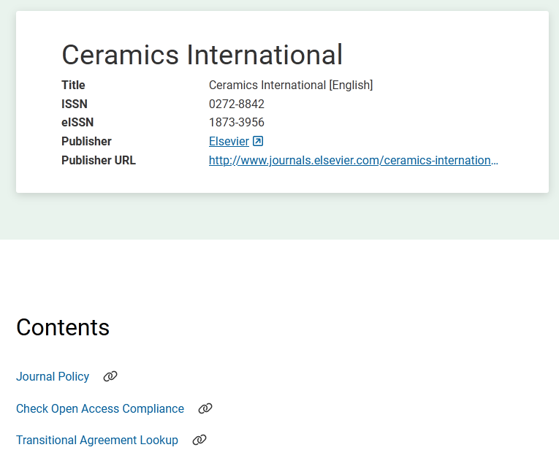
How to know what can be deposited?
Find the self-archiving policy on the journal’s/publisher’s website
Examples:
https://www.springer.com/it/open-access/publication-policies/self-archiving-policy
https://academic.oup.com/pages/self_archiving_policy_b
Check Sherpa Romeo:
https://www.sherpa.ac.uk/romeo/
https://beta.sherpa.ac.uk/

Slide 15
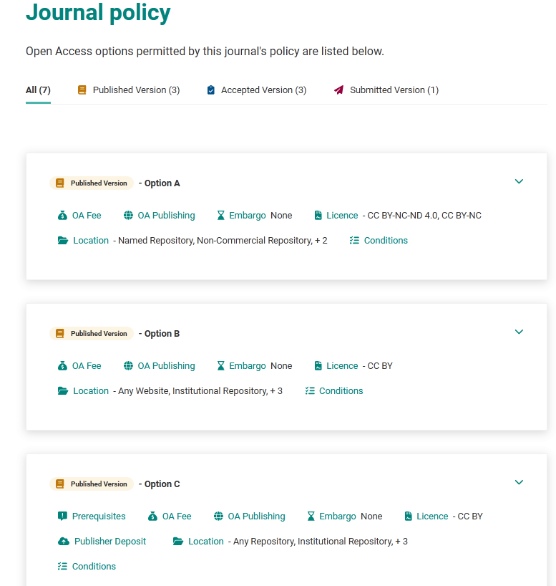
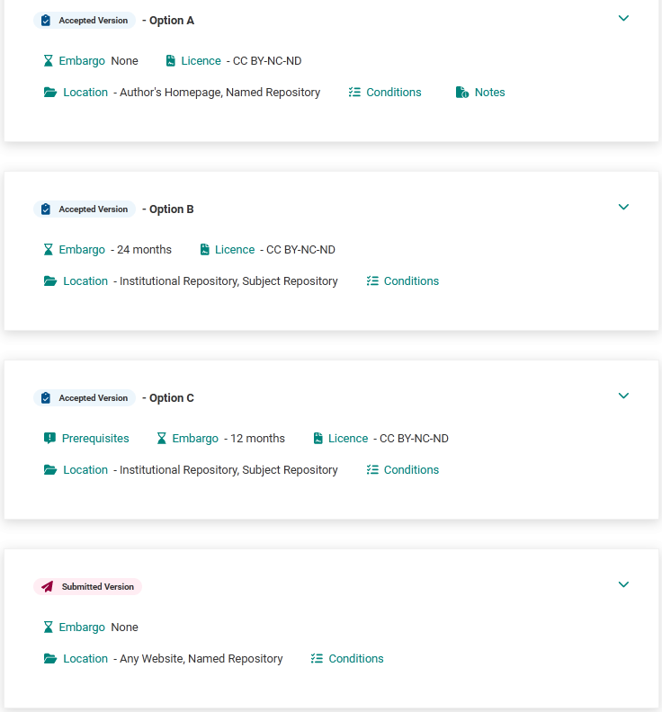

Slide 16
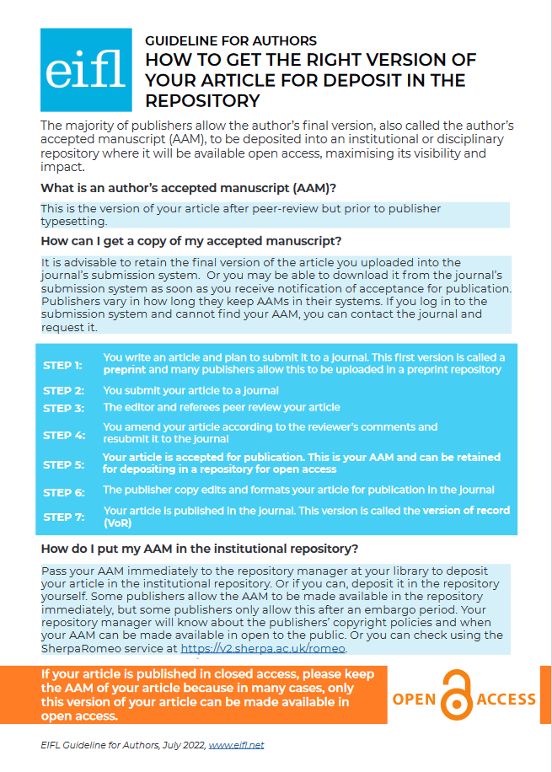
Getting the right version of a journal article
Guideline: https://www.eifl.net/resources/authors-how-get-right-version-your-article-deposit-repository
Webinar: https://www.eifl.net/blogs/open-access-repositories

Slide 17
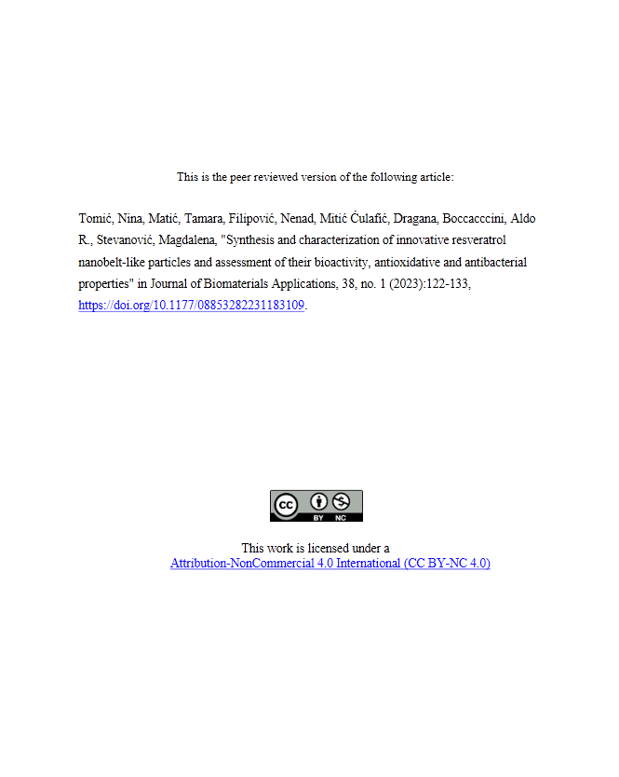
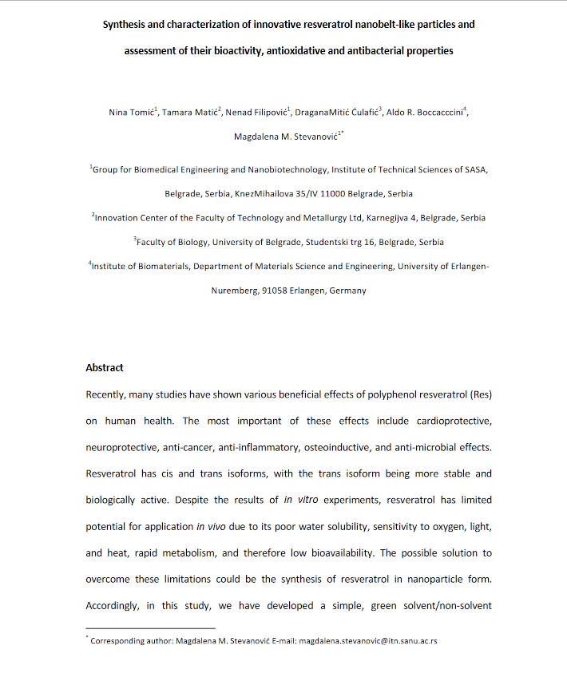
Create a title page in the PDF to make it easy for users to identify and cite the publication.
https://hdl.handle.net/21.15107/rcub_dais_15195

Slide 18
Depositing content that is already OA
Policy requirement in Serbia (both national and institutional)
Better preservation
More complete insight into the output of an institution
It’s easier to generate reports using repository
More efficient dissemination

Slide 19
Preparing PDFs for depositing
Full text (not excerpts or ‘previews’)
Must contain sufficient information to enable unambiguous identification of the publication (e.g. PDF of a book chapter/conference object includes the full text + preliminary pages, e.g. https://hdl.handle.net/21.15107/rcub_dais_12282)
Preferably PDF/A
Can be a scan if there is no other option; OCR if possible; if not, deposit what you have and provide a better version when possible.

Slide 20
Beyond formal publications
Motivation
Heritage flavour
Systematic archiving
Individual requests (I have this material, it’s not relevant for research assessment, but I’ve invested some effort and want to show it to the world)
Sharing materials interesting to a general audience
Conference posters
Event posters (e.g. https://hdl.handle.net/21.15107/rcub_dais_16594)
Images (https://tinyurl.com/3enbfjy7)
Presentations (e.g. https://hdl.handle.net/21.15107/rcub_dais_578)
Video (e.g. https://hdl.handle.net/21.15107/rcub_dais_14828)
Audio (e.g. https://hdl.handle.net/21.15107/rcub_dais_11893)
Datasets (https://tinyurl.com/54w35ezf)
Reports (e.g. https://hdl.handle.net/21.15107/rcub_dais_15495)
Event booklets (e.g. https://hdl.handle.net/21.15107/rcub_dais_11194)
Bibliographies (e.g. https://hdl.handle.net/21.15107/rcub_dais_11865)
CD booklets (e.g. https://hdl.handle.net/21.15107/rcub_dais_4805)
According to a research conducted in 2021 repository managers in Serbia, systematic archiving of all outputs, greater visibility of research outputs, making monitoring and reporting easier and enabling OA are seen as the main reasons for establishing an institutional repository. However, systematic archiving is still not possible to achieve due to limited resources. https://doi.org/10.5281/zenodo.5786272

Slide 21
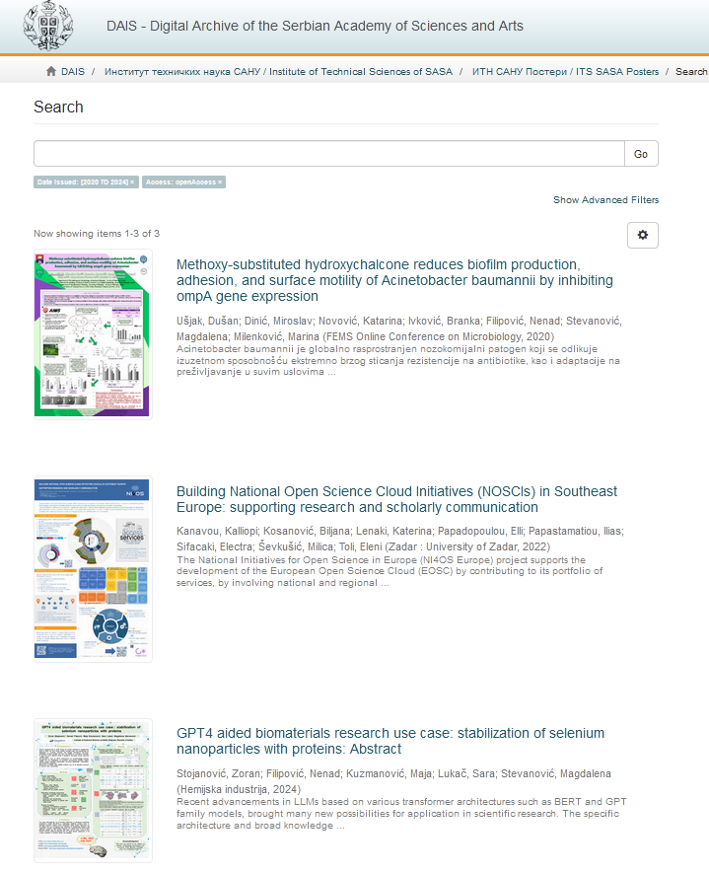
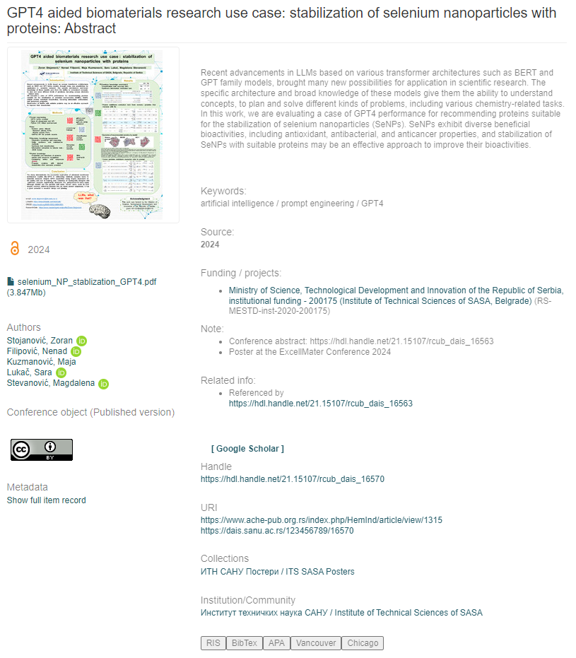
Posters
https://dais.sanu.ac.rs/handle/123456789/2463
https://hdl.handle.net/21.15107/rcub_dais_16570

Slide 22
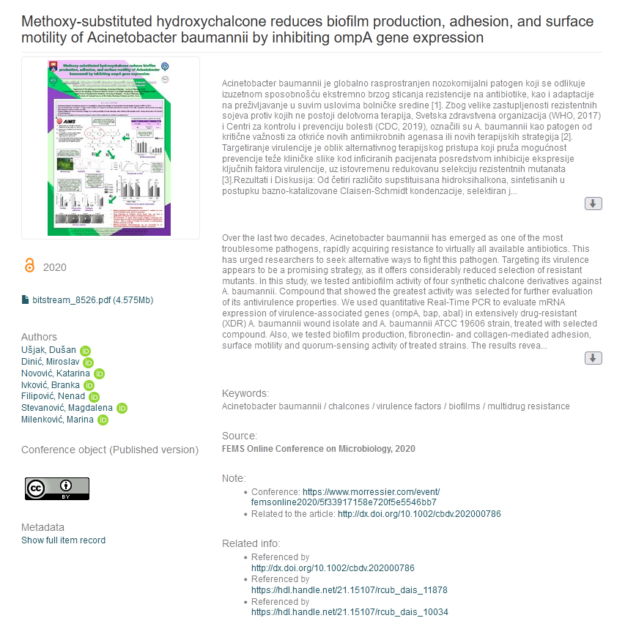
Connecting related outputs
Poster presented at a conference is deposited in the repository
The research was later published in a journal article.
VoR is archived in the repository but it’s not publicly available.
AAM is deposited and is available after the expiration of the embargo period.
Supplementary information is deposited.
Everything is linked.
Unique and persistent handle is assigned:
Information that there is a related journal article
Links to the related content in the repository
https://hdl.handle.net/21.15107/rcub_dais_10086

Slide 23
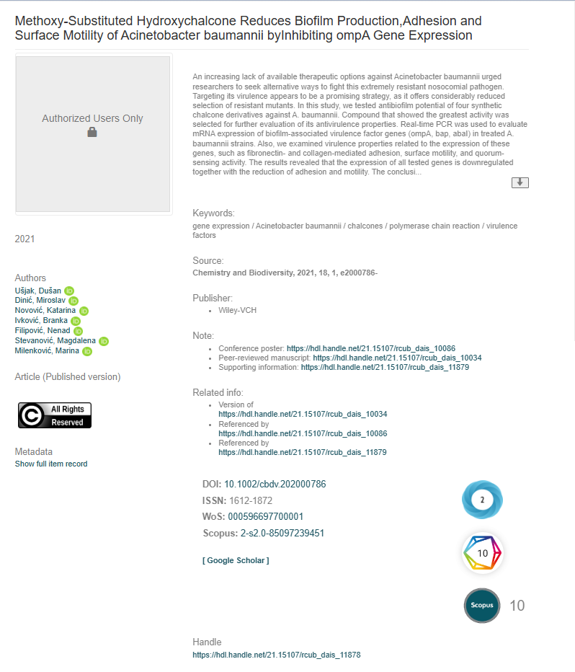
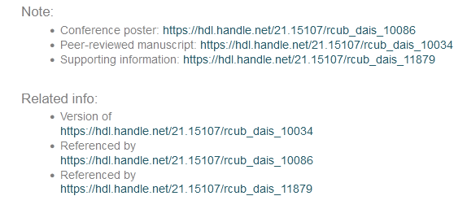
VoR
https://hdl.handle.net/21.15107/rcub_dais_11878

Slide 24
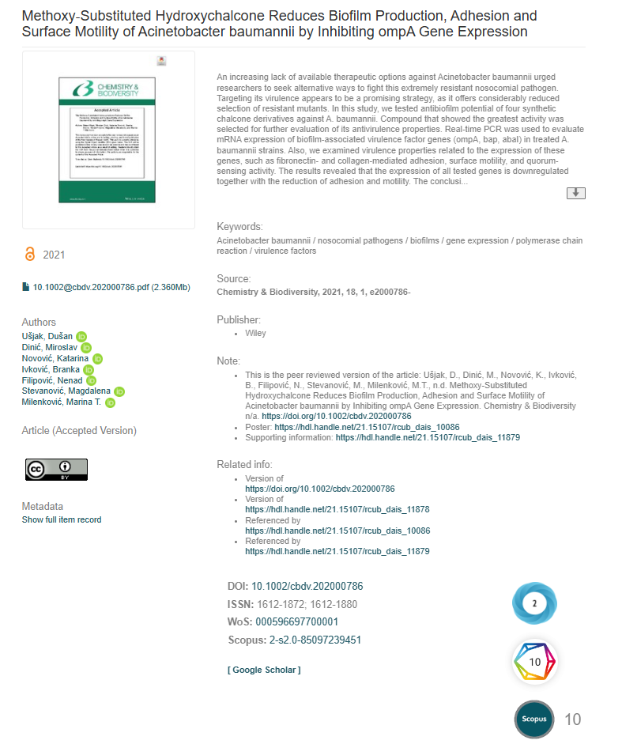
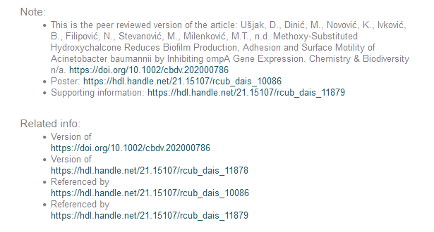
AAM - metadata
https://hdl.handle.net/21.15107/rcub_dais_10034

Slide 25
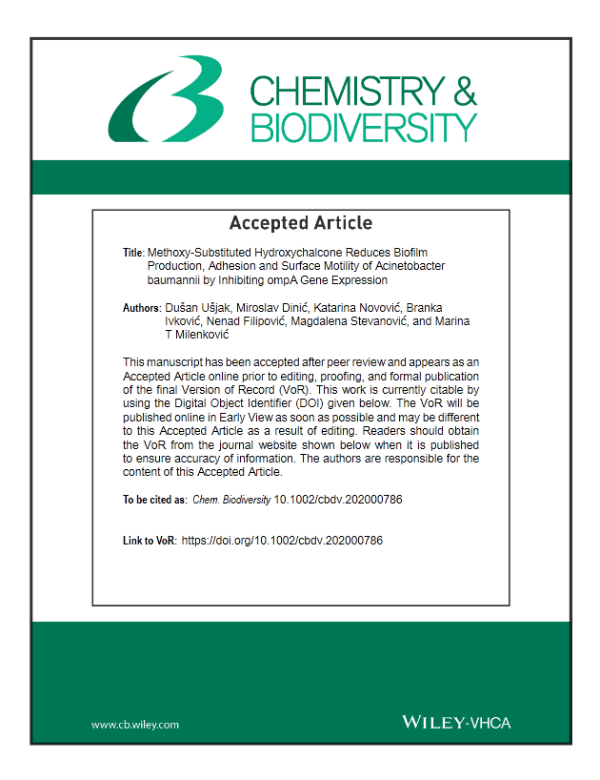
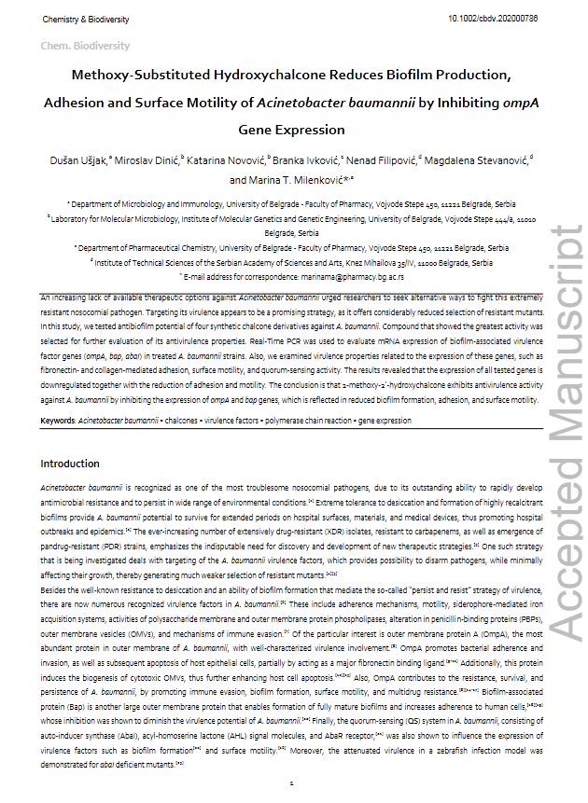
AAM
file

Slide 26
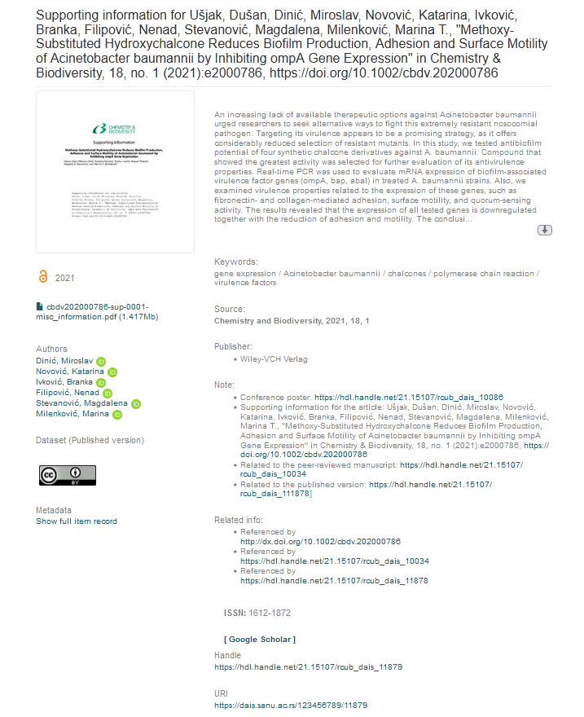
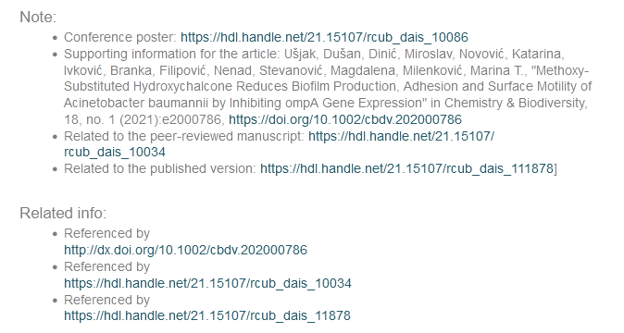
Supporting information
https://hdl.handle.net/21.15107/rcub_dais_11879

Slide 27
Support
User manual: https://tinyurl.com/2s4jtbzm
Manual for repository managers: https://tinyurl.com/28zaswpk
Additional guidelines ensuring metadata compliance between repositories and the national CRIS system: https://tinyurl.com/7pn238bt
Documentation (detailed description of the system, workflows, responsibilities, preservation plan, etc.): https://repowiki.rcub.bg.ac.rs/index.php/DAIS_-_Digital_Archive_of_the_Serbian_Academy_of_Sciences_and_Arts:_General_information
User support (helpdesk)
Training

Slide 28
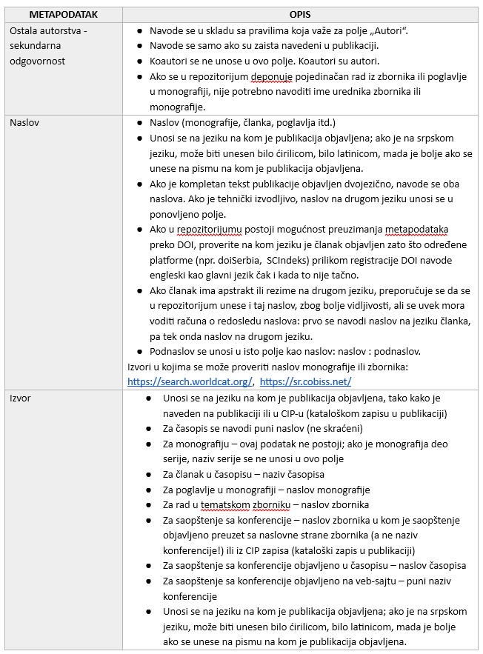
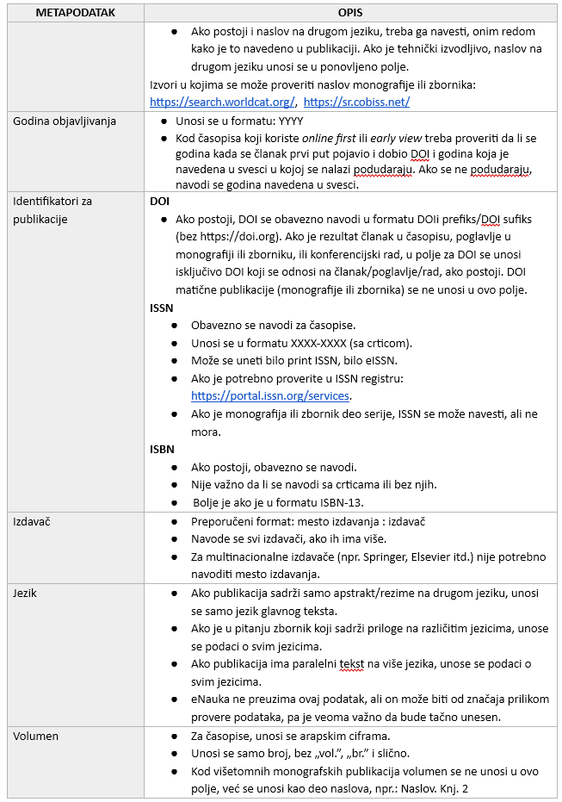
How to create metadata

Slide 29
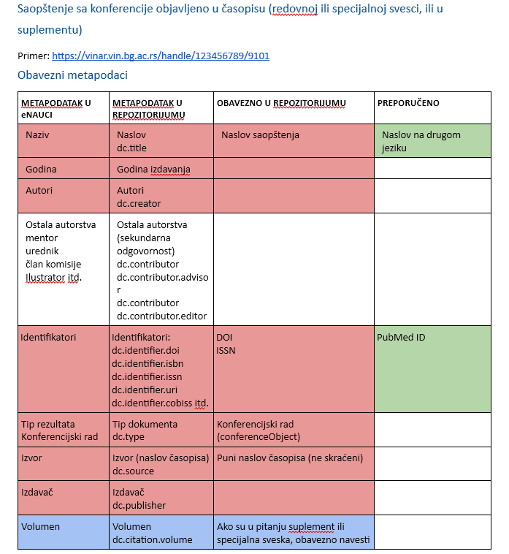
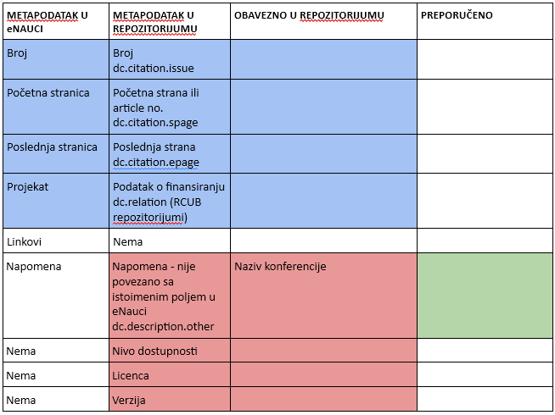
Guides
Example: Guide for Serbian RPOs explaining mandatory and optional metadata to be provided when depositing various research outputs in an institutional repository. It shows the mapping between repository metadata and metadata in the national CRIS system.
It is also explained what PDFs for each output type should include and examples are provided.

Slide 30
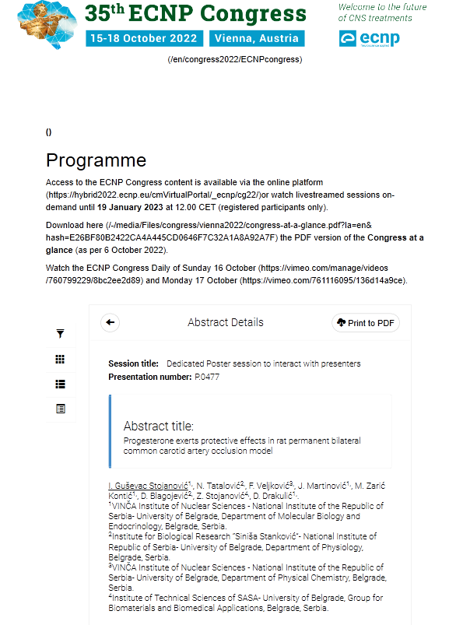
Example: How to deposit a conference abstract published on a conference website
Save the abstract as a PDF
Save the page with the conference information (name, date, place, conference boards, etc.) as a PDF
Merge PDFs
If needed, create a title page containing relevant information in the PDF
Follow these instructions to archive the page with the abstract/paper in the Internet Archive: https://help.archive.org/help/save-pages-in-the-wayback-machine/
Follow the guide to create metadata

Slide 31
Motivating researchers
Advocate for adopting a policy
Demonstrate how repositories improve the visibility of their research (https://openplato.eu/pluginfile.php/9371/mod_resource/intro/Benefits_of_Repositories.pptx.pdf)
Explain differences between repositories and social networking sites
Show statistics (visits and downloads) in the repository and in aggregators
Show harvested repository records in aggregators
Show repository records in Google Scholar (search site:repository.domain, e.g. site:dais.sanu.ac.rs)
Explain how Unpaywall, OA Button and CORE Discovery button work
Search your repository domain here https://en.wikipedia.org/wiki/Special:LinkSearch to see how many repository items are cited in Wikipedia (instructions: https://openplato.eu/mod/page/view.php?id=1246)

Slide 32
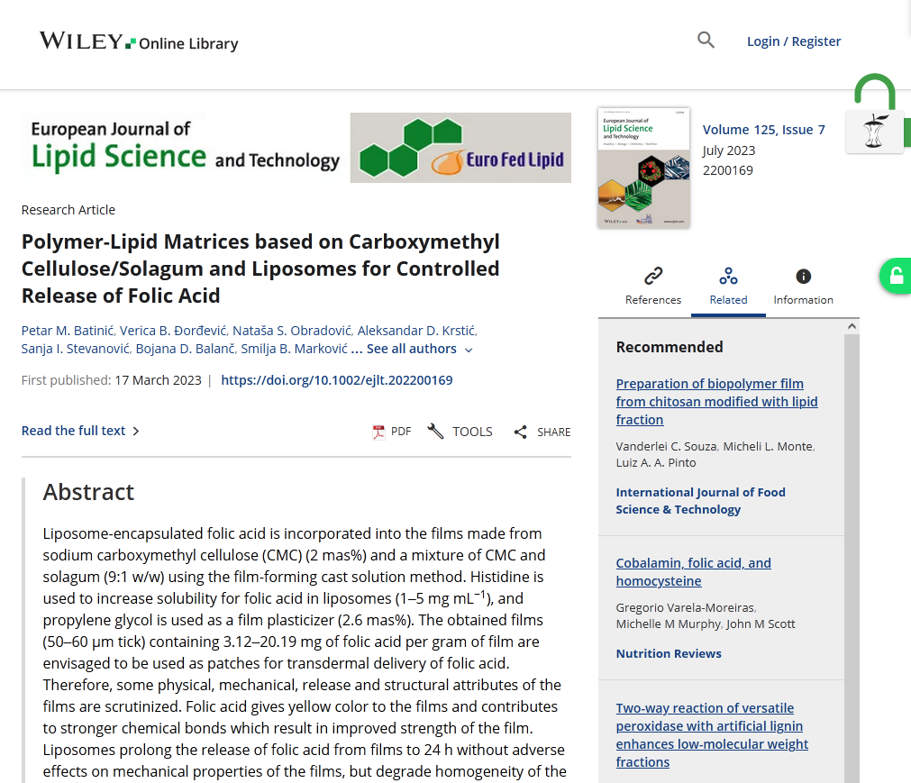
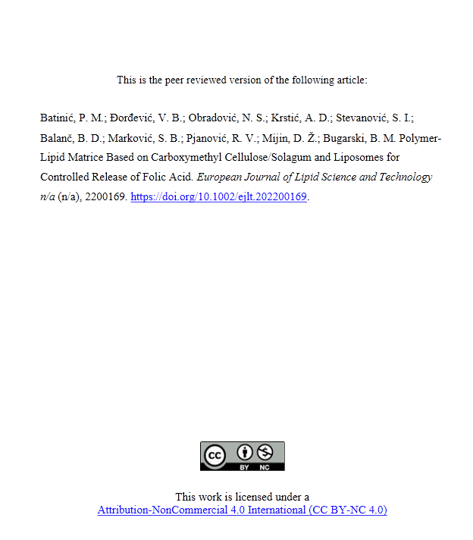
Finding OA AAMs:CORE Discovery button and Unpaywall button

Slide 33
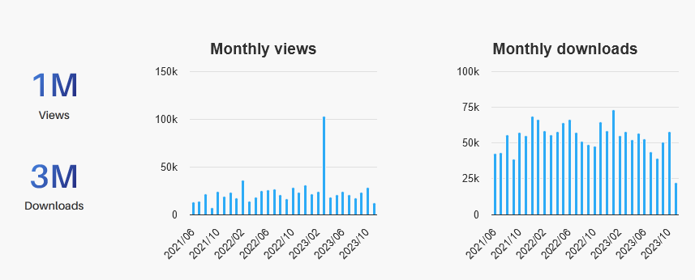
Effects
https://www.base-search.net/about/en/about_sources_date.php
https://explore.openaire.eu/search/dataprovider?datasourceId=openaire____::9689110ea9ceb0be3cf0606bb641af74

Slide 34
What can be done?
Advocate for the adoption of a policy and get involved in its drafting (if there is no policy)
Help draft any documents supporting the policy (rules, instructions
Draft a repository policy and other documentation
Prepare guides and training materials
Provide training
Provide support
Allocate staff, if possible; if not, rearrange duties to make it possible for the existing staff to manage the repository.

Slide 35
Questions?
milica.sevkusic@eifl.net
X: @lessormore4
Template Green Marketing, designed by Jimena Catalina; Slides Carnival. CC BY
Photo by Agence Olloweb on Unsplash

