Slide 2
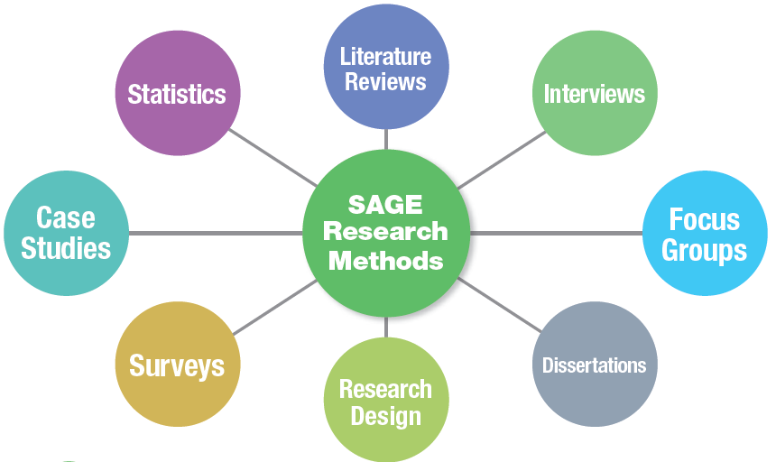
Over 1,000 books, journals, videos and reference material
Bespoke research tools
Resources to prepare and write up methodology for publication
Research models, reading lists and practice material

Slide 3
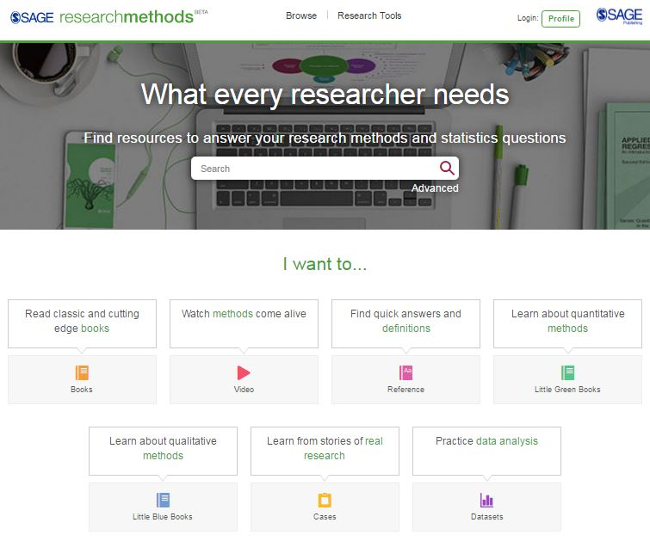
Exclusive research tools
Modern interface, optimized for mobile use
Main site search, with advanced options
Content search – look only at specific collections

Slide 4
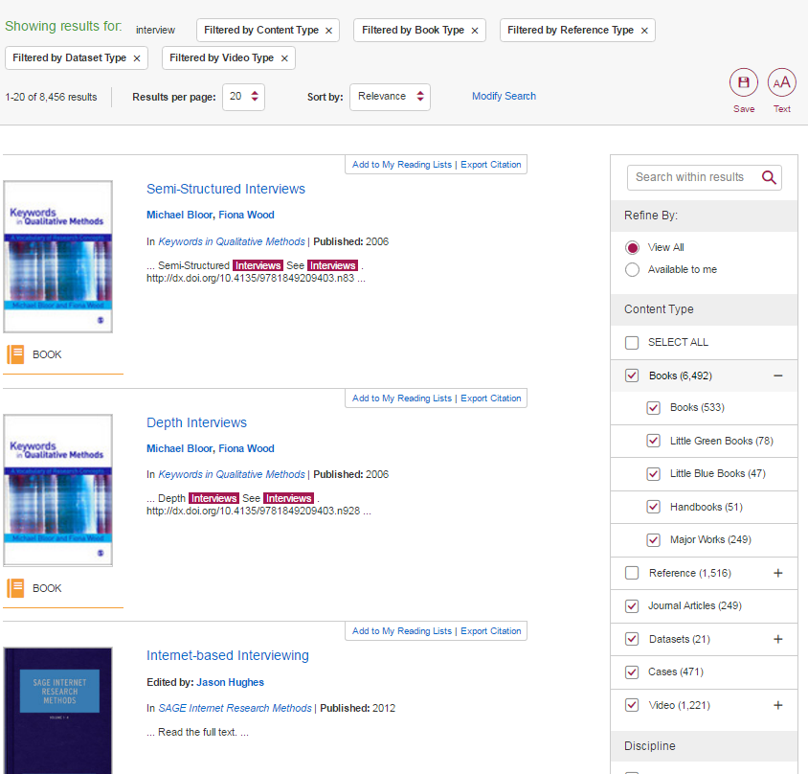
Search criteria and filters
Search results with advanced filtering options
Add to a reading list or export a citation directly from results
Notes:
Top menu shows search criteria
Side menu allows to
Search within results
Refine by content type, discipline, or, further down, also date

Slide 5
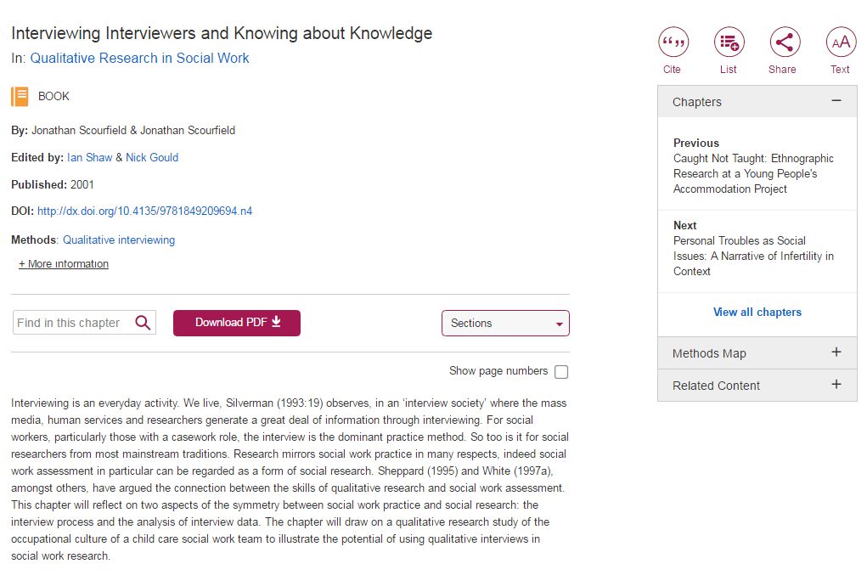
Content page, with taxonomy tags and metadata links
See other chapters, place it in context in the methods map, or find related content in the platform
Users can search contents, download pdf, and jump to specific sections
Notes:
Content page includes sections/chapters on right-hand side menu, as well as links to methods map and related content within the site
Quick menu for sections, option to download pdf, and search text

Slide 6
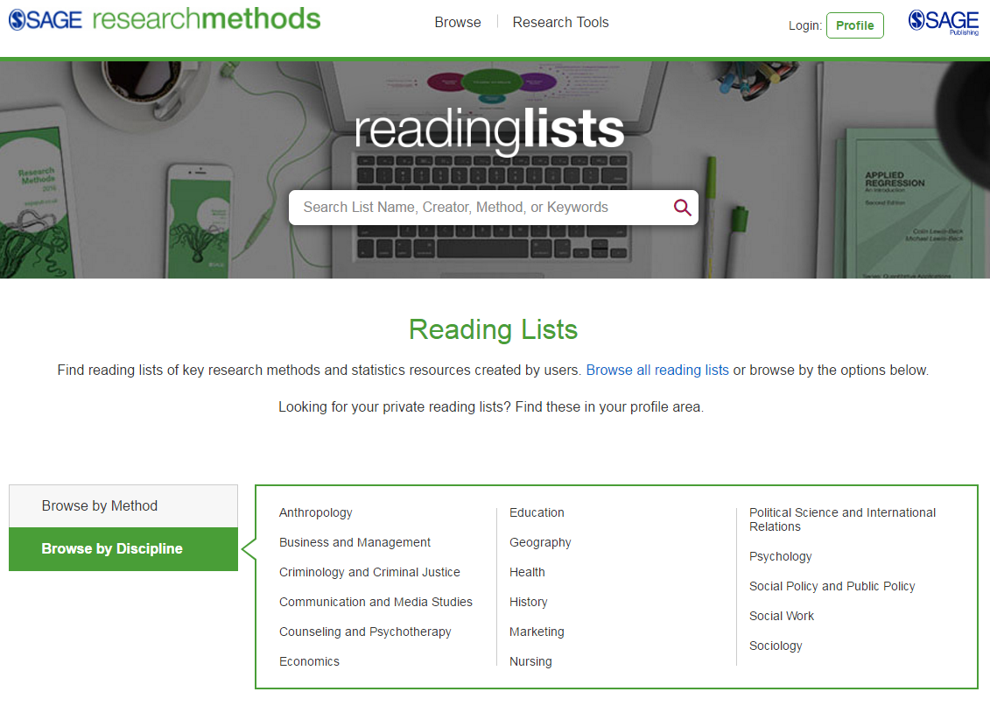
Reading lists
Users can create and share unlimited private or public lists
Browse existing public lists by discipline or method

Slide 7
Methods Map
Interactive visualization of methods in context
Find relevant content, broader, narrow, or related terms

Slide 8
Project Planner
Step-by-step guide to help users plan their research project
Each section includes curated and downloadable content

Slide 9
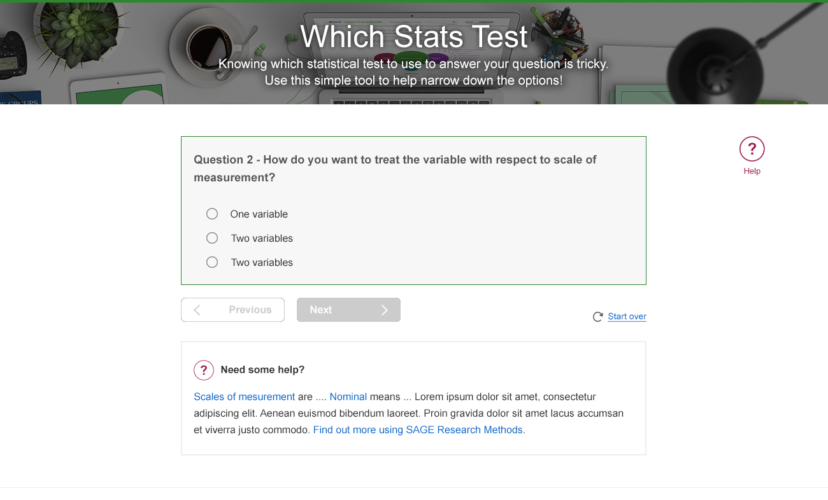
Which Stats Test
A guide to choosing the best method to analyse your project’s data
With additional content explaining each concept

Slide 10
Free trials available!
Sagepub.com/trial
journalsales@sagepub.co.uk
Notes:
The Publisher of the Social Sciences

