Slide 1
DSpace 7 overview & resources
Iryna Kuchma, Open Access Programme Manager
Attribution 4.0 International

Slide 2
Reusing slides from DSpace 7 Q&A Webinar
Tim Donohue, LYRASIS

Slide 3
Why DSpace 7?
01
Single User Interface (built on Angular.io)
Redesigned, modernized, themeable
Enhanced User Privacy (GDPR alignment)
WCAG 2.1 AA alignment
02
Fully-featured, integration-ready REST API
03
Support for OpenAIRE v4
04
Configurable Entities (Person, Project, Publication, etc)
05
Can upgrade from any prior release of DSpace (after installing the new UI)
06
Coming soon: Signposting, ResourceSync, Notify Project implementation
Aligning with COAR Next Generation Repositories
07
Backwards compatible with existing integrations
Still includes OAI-PMH, SWORD (v1/v2), old REST API (v6), etc
08
Secure & stable out-of-the-box
Every code change has automated tests (TDD)
Every code change is scanned for security vulnerabilities

Slide 4
7.x Releases (so far)
7.0 (Aug 2021)
New User Interface (redesigned search, deposit, admin tools)
New REST API (all data/features available for integrations)
OpenAIRE v4 support
Configurable Entities (Person, Project, Publication, etc.)
7.1 (Nov 2021)
IIIF Support, Request a Copy, Item Versioning, OAI Harvesting
7.2 (Feb 2022)
Runtime configs for User Interface, Item Embargos, Feedback form, OpenID Connect Auth
7.3 (June 2022)
ORCID, Importing data from 9 new sources, Versioning of Entities, Control Panel, Sherpa/Romeo, type-based submission, RSS, etc..

Slide 5
What’s new in 7.3?

Slide 6
7.3 New Features
ORCID authentication & sync to Researcher Profile
Login via ORCID & easily create/claim a Researcher Profile page in DSpace
Optionally, sync your Profile (and linked Publications) with your ORCID account.
Admin Control Panel
“Health” panel checks DSpace & reports if any parts are not functioning
Import content from any of the following systems
CrossRef, Scopus, CiNii, Web of Science, NASA Astrophysics Data Systems (ADS), VuFind.org, PubMed Europe, SciELO.org, European Patent Office (EPO)
Configurable Entities support Item Versioning
New version of an entity retains its relationships. Old version’s relationships become “static”.
Performance improvements: initial UI page load is much quicker!

Slide 7
7.3 Migrated Features (from 6.x)
These are new to 7.x, but existed (in a similar form) in 6.x or below.
Preview / validate a batch metadata CSV’s changes during upload
Submission forms support SHERPA/RoMEO publisher policies (ISSN lookup)
Submission forms support type-based fields
Preview an item during workflow approval
RSS/Atom feeds for Site and every Community/Collection
Withdrawn items now have a tombstone page

Slide 8
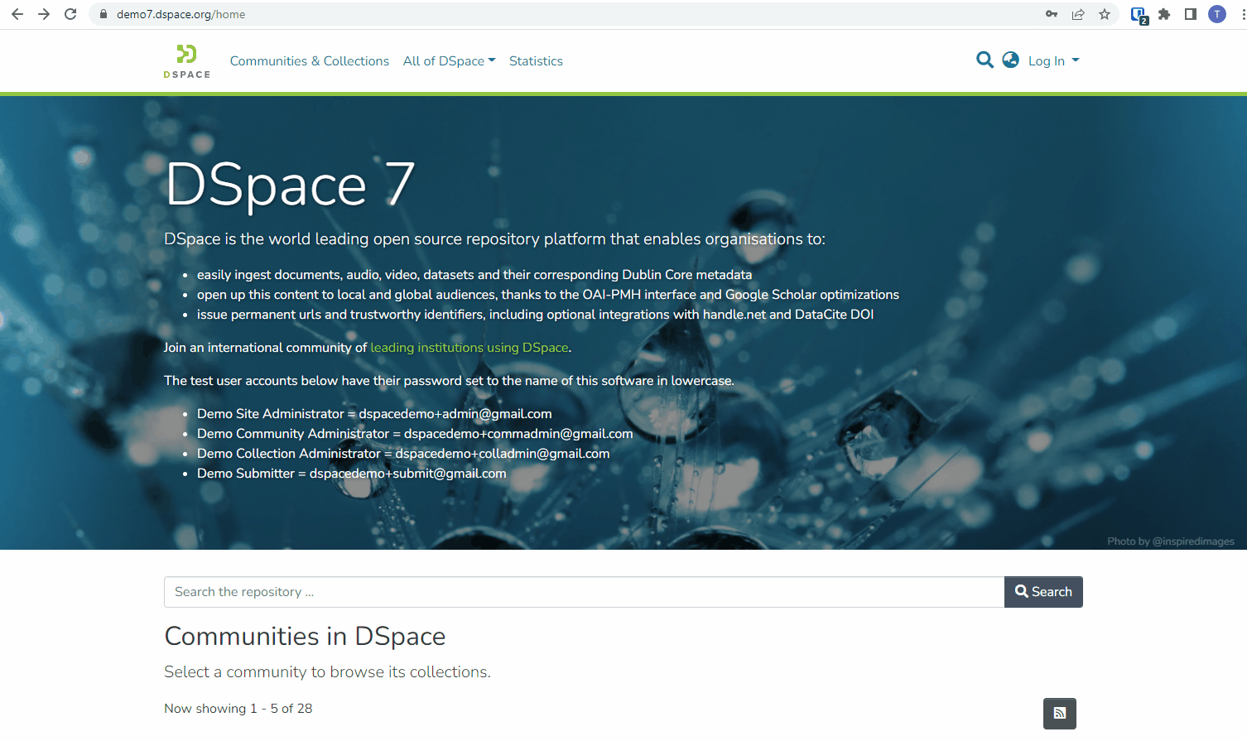
ORCID Authentication & Researcher Profile
Login using ORCID and sync your info to a DSpace profile.
Notes:
This demo shows login via ORCID, followed by creation of a “Researcher Profile” page (which is a Person Entity) that can be synced with your ORCID profile (either manually or automatically). Any Publication Entities linked to your Researcher Profile would also be synced to your ORCID profile (when synchronization of publications is enabled).

Slide 9
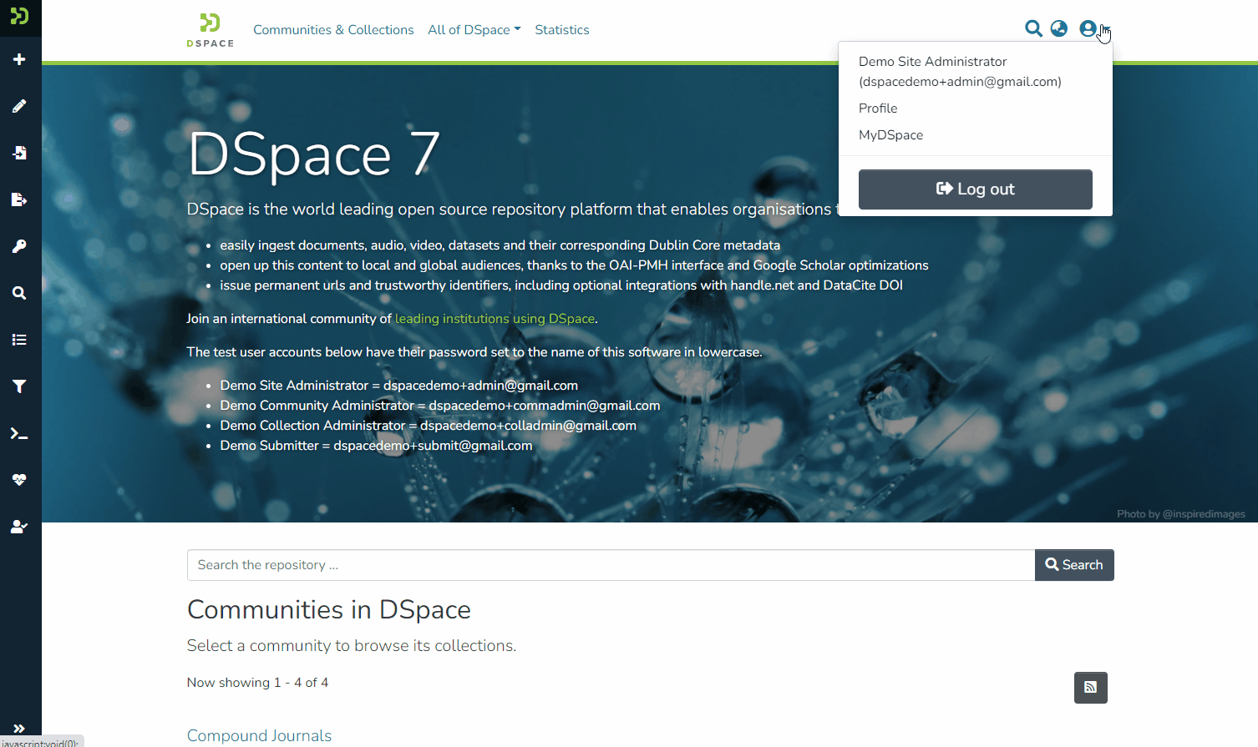
Admin Control Panel - “Health”
Diagnose possible issues in your DSpace.
Notes:
This demos the new Administrative “Health” control panel. A version of this existed in DSpace 6, but it’s been redesigned and updated to *validate* your DSpace backend components. If no issues are detected, a green checkmark appears. If you have a warning, you’ll see the yellow triangle. If there is a major issue (something has crashed or is down) a red “X” will appear.
In this demo…
“Status” tab shows that there are possible issues with this installation. GEO IP (used for internal statistics) isn’t setup properly. It gives a useful error message for how to resolve it.
It also shows that both Solr and Database passed the validation checks, so they have green checkmarks.
“Info” tab displays configuration information about the backend. It can be used to verify current configurations, especially if a problem exists on the “Status” panel.

Slide 10
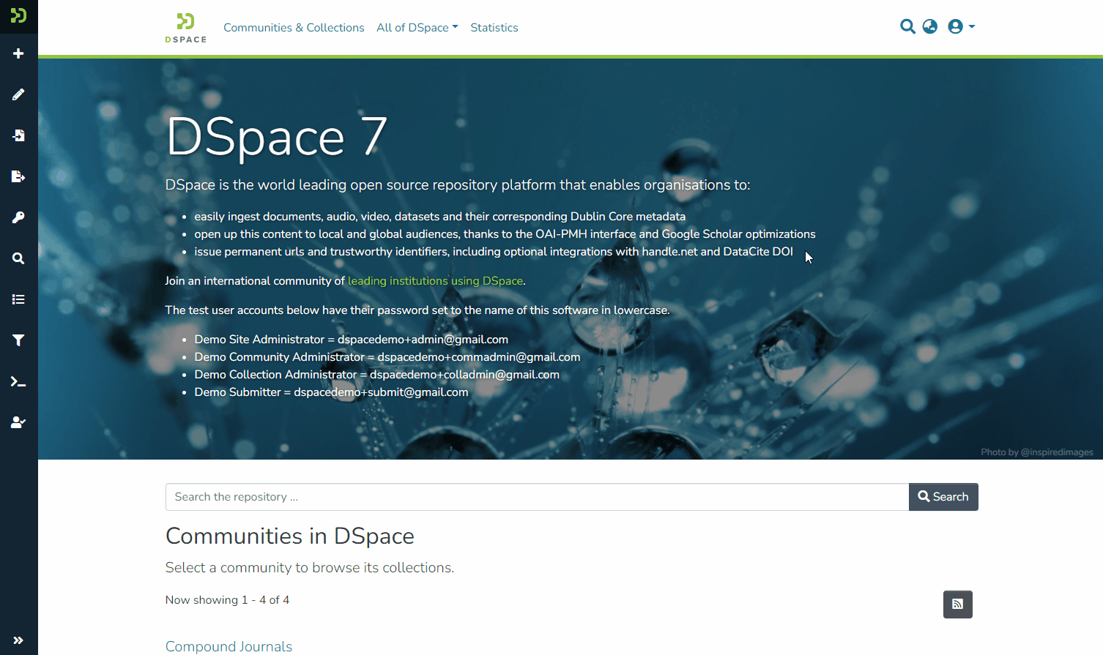
Import from External Sources - CrossRef
Quickly import metadata from external sites!
Notes:
This demo shows how to import content from CrossRef (new in 7.3).
Select type of content you are importing into (In demo we select a Publication Entity, but normal Items are also supported)
Select the site you wish to search (In demo we select CrossRef, but you’ll see other options listed)
Type in a search. Select an item from the results
You see a preview of the metadata that can be imported
Select a Collection to import into. A new Submission is created with the imported metadata.
From there, all you would need to do is upload file(s) and complete the submission.

Slide 11
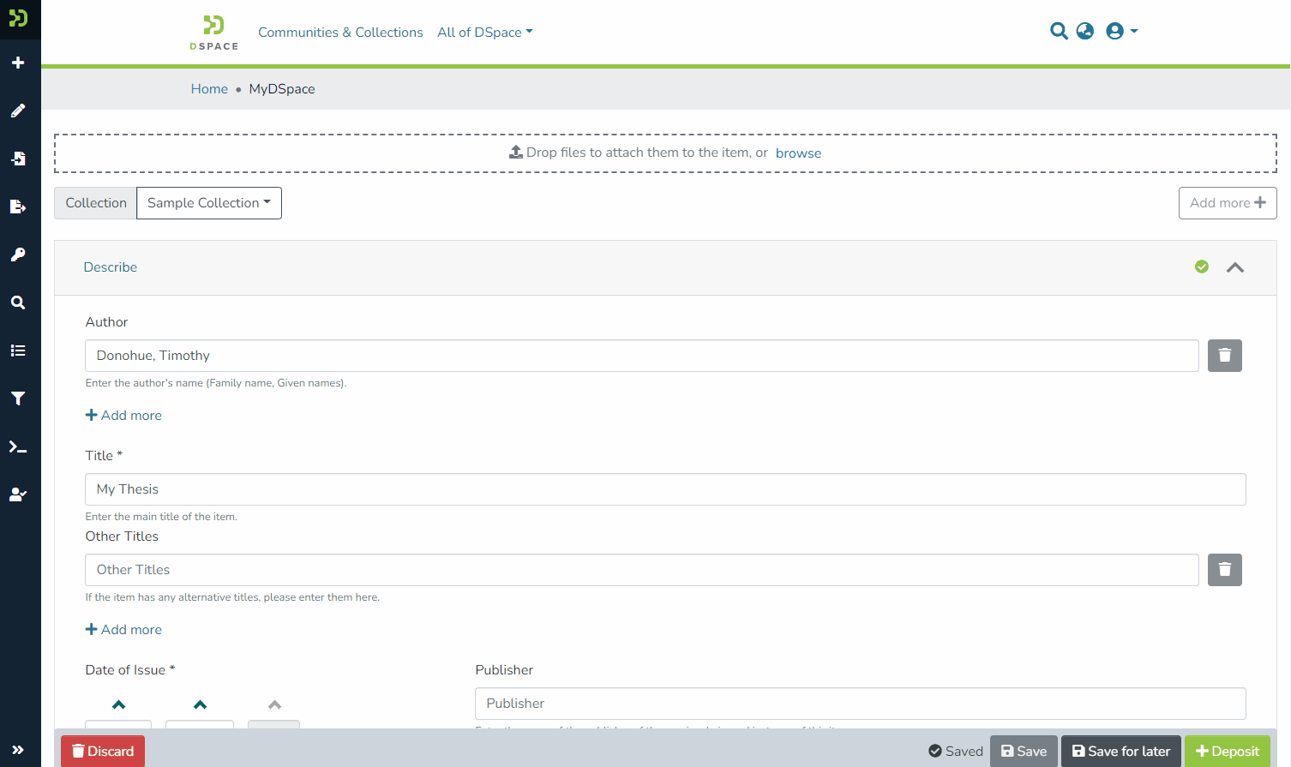
Support for Type-based Fields
Based on the Type selected, other fields may appear!
Notes:
This is a feature from 6.x that has been ported to 7.x.
Some fields in your submission form can be configured as Type-based. This means that if the submitter selects a specific “Type” those field(s) may either appear or disappear from the form.
In the above demo, we can see that when “Type=Book” a new field named “ISBN” appears. When Type is then switched to “Thesis”, the “ISBN” field disappears and a new “Thesis Advisors” field appears.

Slide 12
Who is developing/building 7.x?

Slide 13
Who is developing/building 7.x?
The DSpace 7 Working Group
Tim leads the team. The other members are volunteering* their time to help build/improve 7.x. All meetings are open & anyone can join the team to help out.
* A few trusted service providers (Atmire & 4Science) have a portion of their development work funded via the DSpace Development Fund. This funded work is prioritized/approved by Tim & DSpace Steering.

Slide 14
How do you decide what is in each 7.x release?

Slide 15
How do you decide what is in each 7.x release?
Based on the feature priority list & any donated features
This priority list was decided by the DSpace Steering Group, based on a survey of the DSpace Leadership Group.
Features are generally built tier by tier
Some exceptions may be made if two features are very closely related and are easiest to build together.
Bugs are prioritized/scheduled whenever a ticket is created
Donated features/improvements are added whenever they have been fully reviewed & approved

Slide 16
What’s coming in 7.4?
https://wiki.lyrasis.org/display/DSPACE/DSpace+Release+7.0+Status

Slide 17
7.4 Release Plan
Prioritized Maintenance (bug fixes, usability fixes, performance)
Report any bugs you’ve found in 7.x!
A few prioritized features that missed 7.3
Bulk import/export from UI, Recent Submissions, etc
A few donated features, perhaps?
7.4 is due in October 2022

Slide 18
7.x releases in 2023
7.x releases will occur every 4 months (3 per year)
7.5 due in February 2023
7.6 due in June 2023

Slide 19
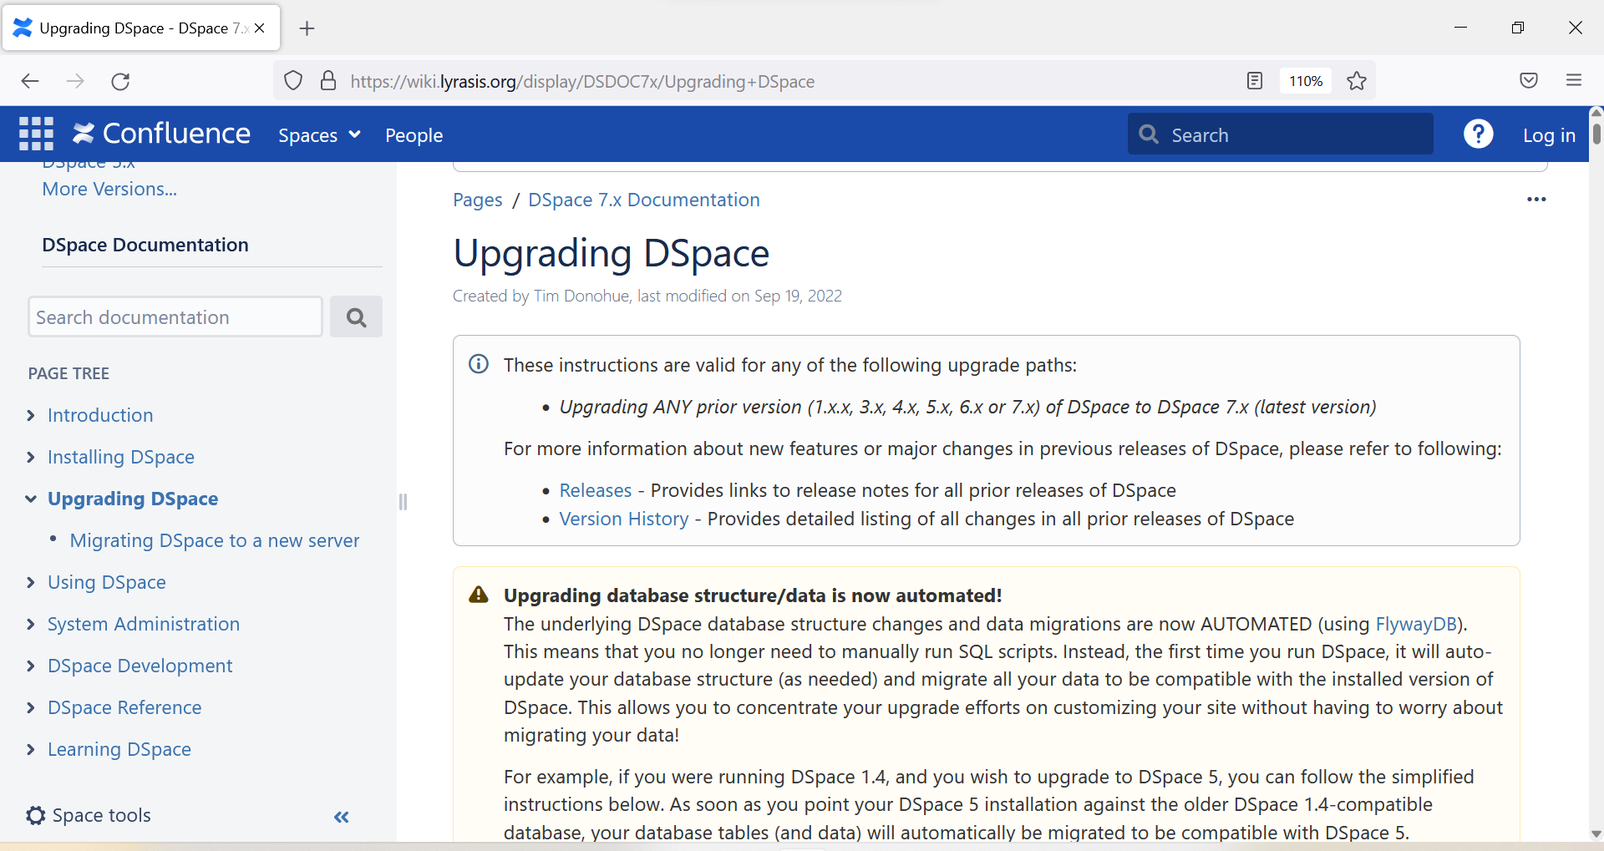
https://wiki.lyrasis.org/display/DSDOC7x/Upgrading+DSpace

Slide 20
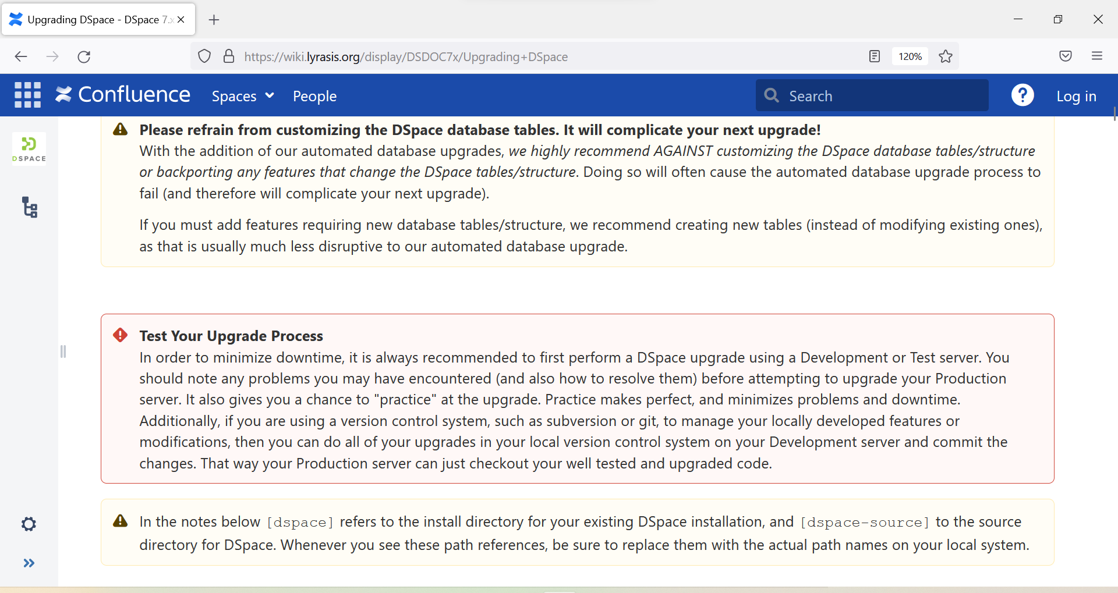
https://wiki.lyrasis.org/display/DSDOC7x/Upgrading+DSpace
https://wiki.lyrasis.org/display/DSDOC7x/Upgrading+DSpace

Slide 21
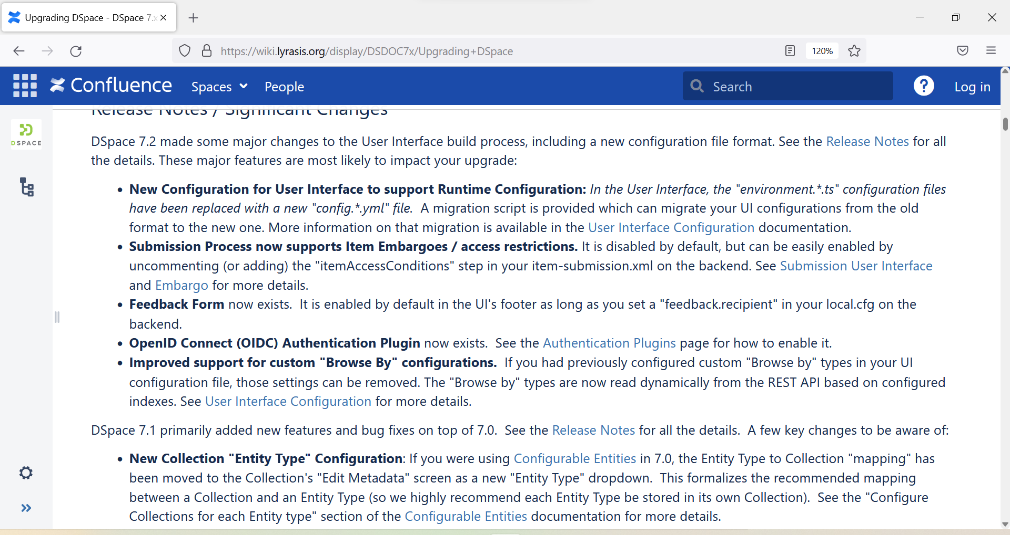
https://wiki.lyrasis.org/display/DSDOC7x/Upgrading+DSpace

Slide 22
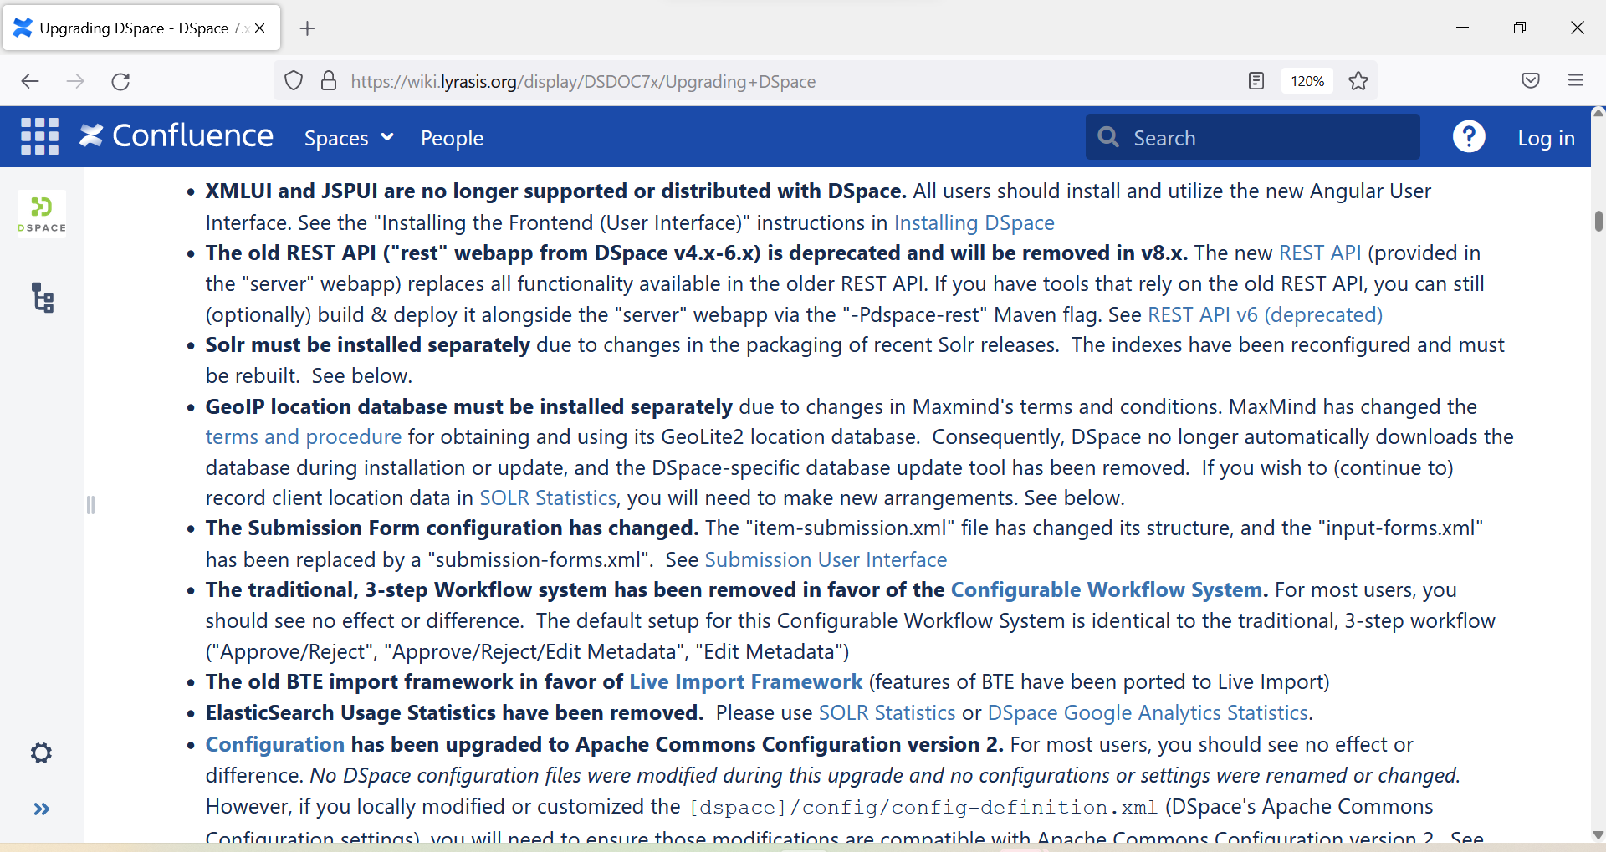
https://wiki.lyrasis.org/display/DSDOC7x/Upgrading+DSpace

Slide 23
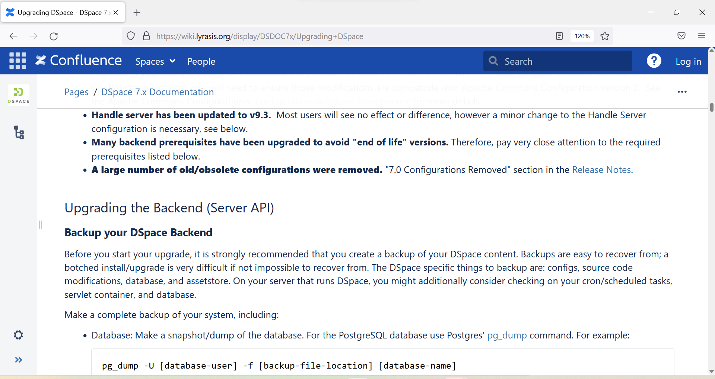
https://wiki.lyrasis.org/display/DSDOC7x/Upgrading+DSpace

Slide 24
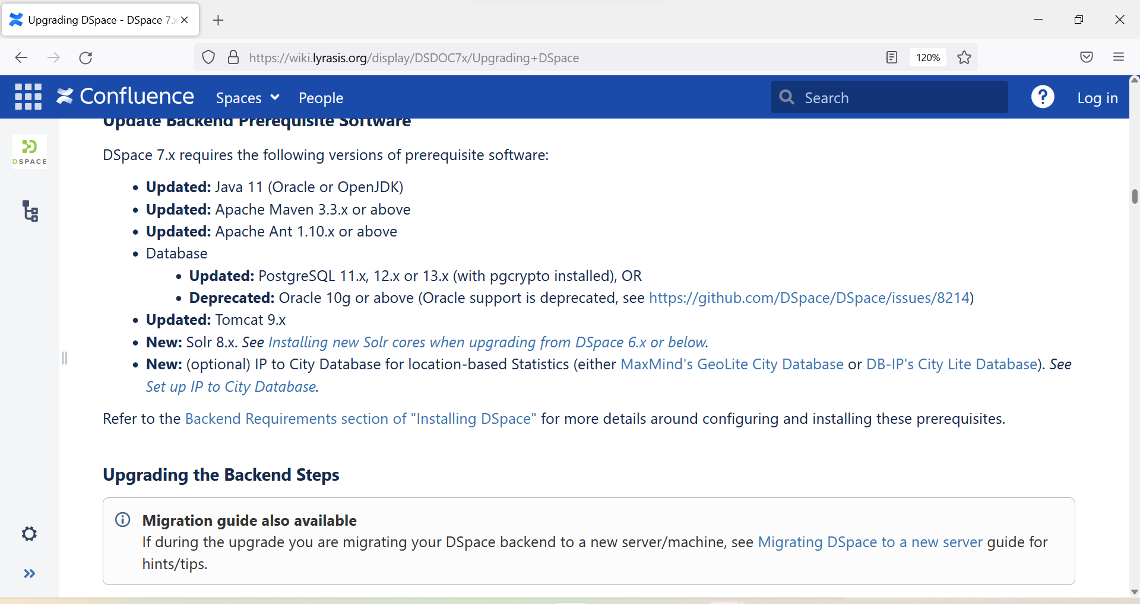
https://wiki.lyrasis.org/display/DSDOC7x/Upgrading+DSpace

Slide 25
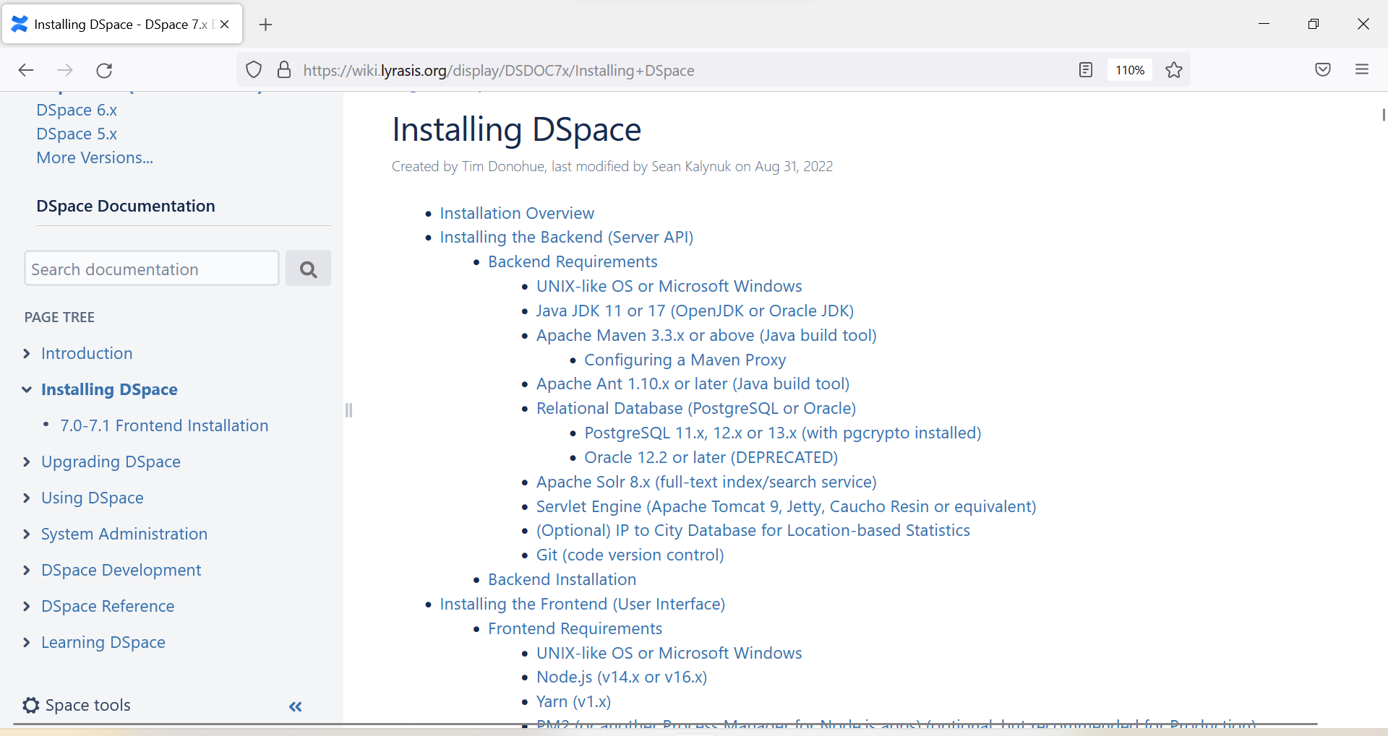
https://wiki.lyrasis.org/display/DSDOC7x/Installing+DSpace

Slide 26
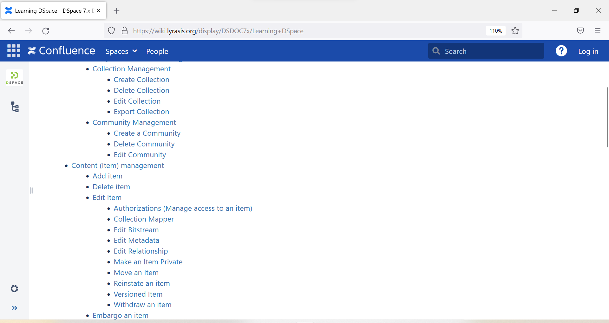
https://wiki.lyrasis.org/display/DSDOC7x/Learning+DSpace

Slide 27
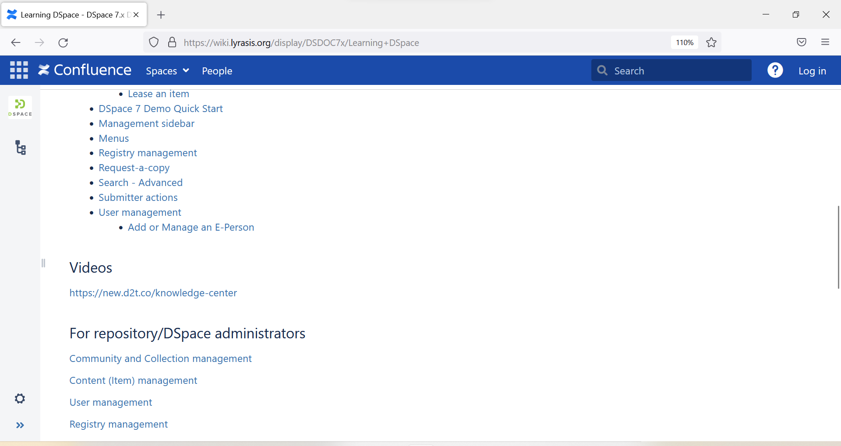
https://wiki.lyrasis.org/display/DSDOC7x/Learning+DSpace

Slide 28
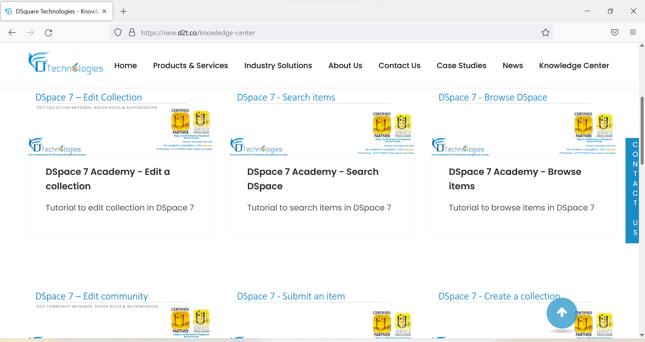
https://new.d2t.co/knowledge-center

Slide 29
How can I help?
Contribute code, review or test in DSpace 7 Working Group
Contribute to “Learning DSpace” documentation
Join DSpace Community Advisory Team (DCAT) discussions
Help us market DSpace in DSpace Marketing Interest Group
Join (or create) your local DSpace User Group
Try out DSpace 7 and report any issues you find
Help Support others on mailing lists & Slack
Become a Member of DSpace
Membership helps to fund full & part-time staff
DSpace Development Fund
Trusted service providers funded to do development for community
Priorities decided by Steering/Leadership

Slide 30
Thank you! Questions?
Contact: iryna.kuchma@eifl.net
@irynakuchma
www.eifl.net

