Slide 1
Bookshare International
March 2018

Slide 2
Hello
Lisa Wadors Verne, Ph.D.
Senior Program Manager: Education, Research and Partnerships
Benetech Global Literacy and Labs
lisaw@benetech.org

Slide 3
Problem and Common Misconception
DIGITAL
≠
ACCESSIBLE

Slide 4
Bookshare

Slide 5
Bookshare is…
…the world’s largest collection of ebooks for people who experience barriers to reading print. Members read in ways that work for them.
Books in 34 languages
Available in over 70 countries
Over 850 publishing partners
24x7 access to books
Read on iOS, Android, Mac, PC
Braille, large text, audio, synchronized text

Slide 7
Imagine If…...

Slide 8
Who Qualifies?
Must be certified by a Competent Authority as having a qualifying print disability:
Low Vision / Blindness
Physical disability that affects reading
Learning disability that affects reading

Slide 9
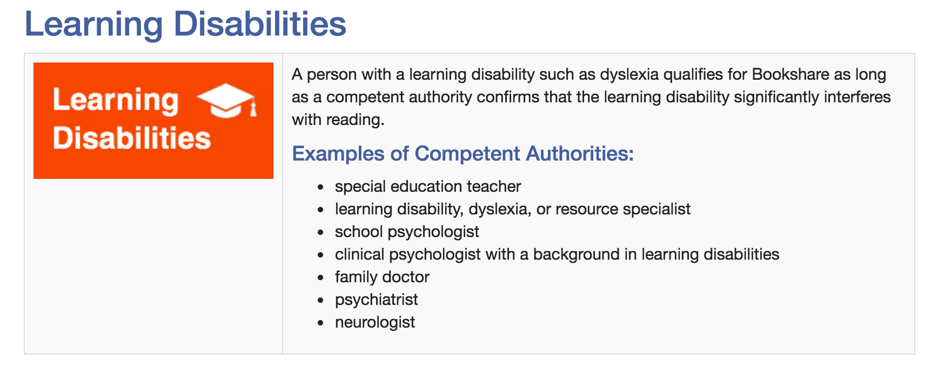
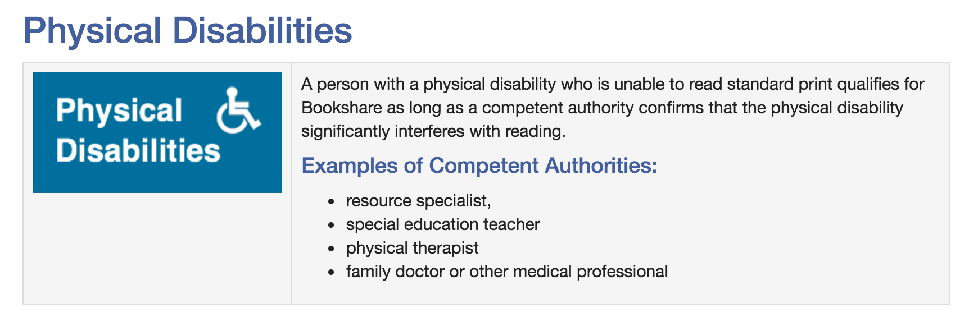
Print Disabilities

Slide 10
Books
There are between 380,000 and 420,000 books available world wide
Leisure reading
Trade books
Languages available vary by country
Lithuania
418,281 – English titles
25 - Russian titles
Palestine
399,028 –English titles
298 –Arabic titles

Slide 11
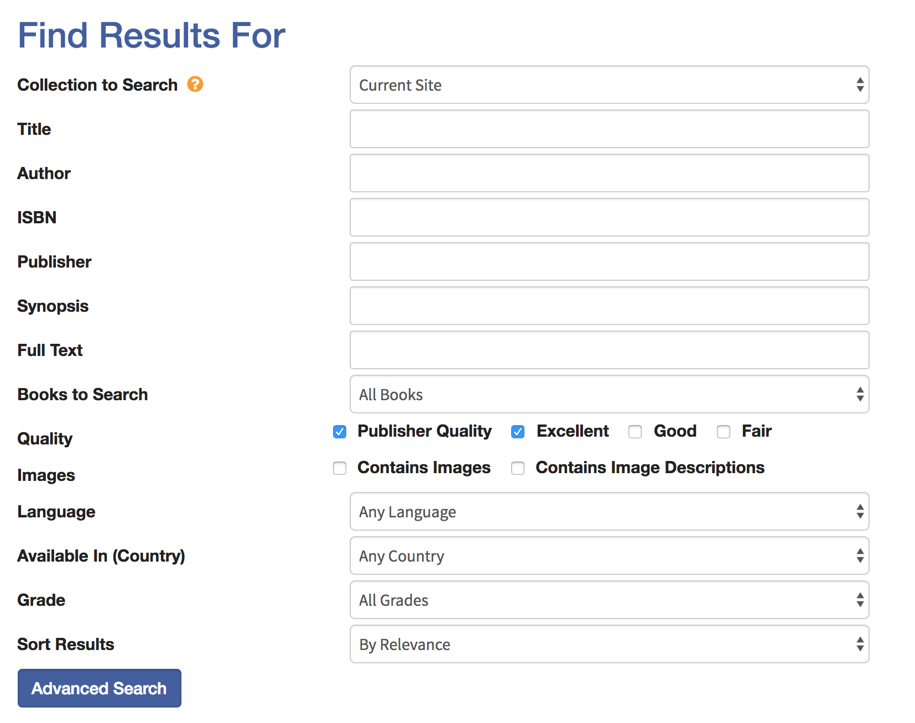
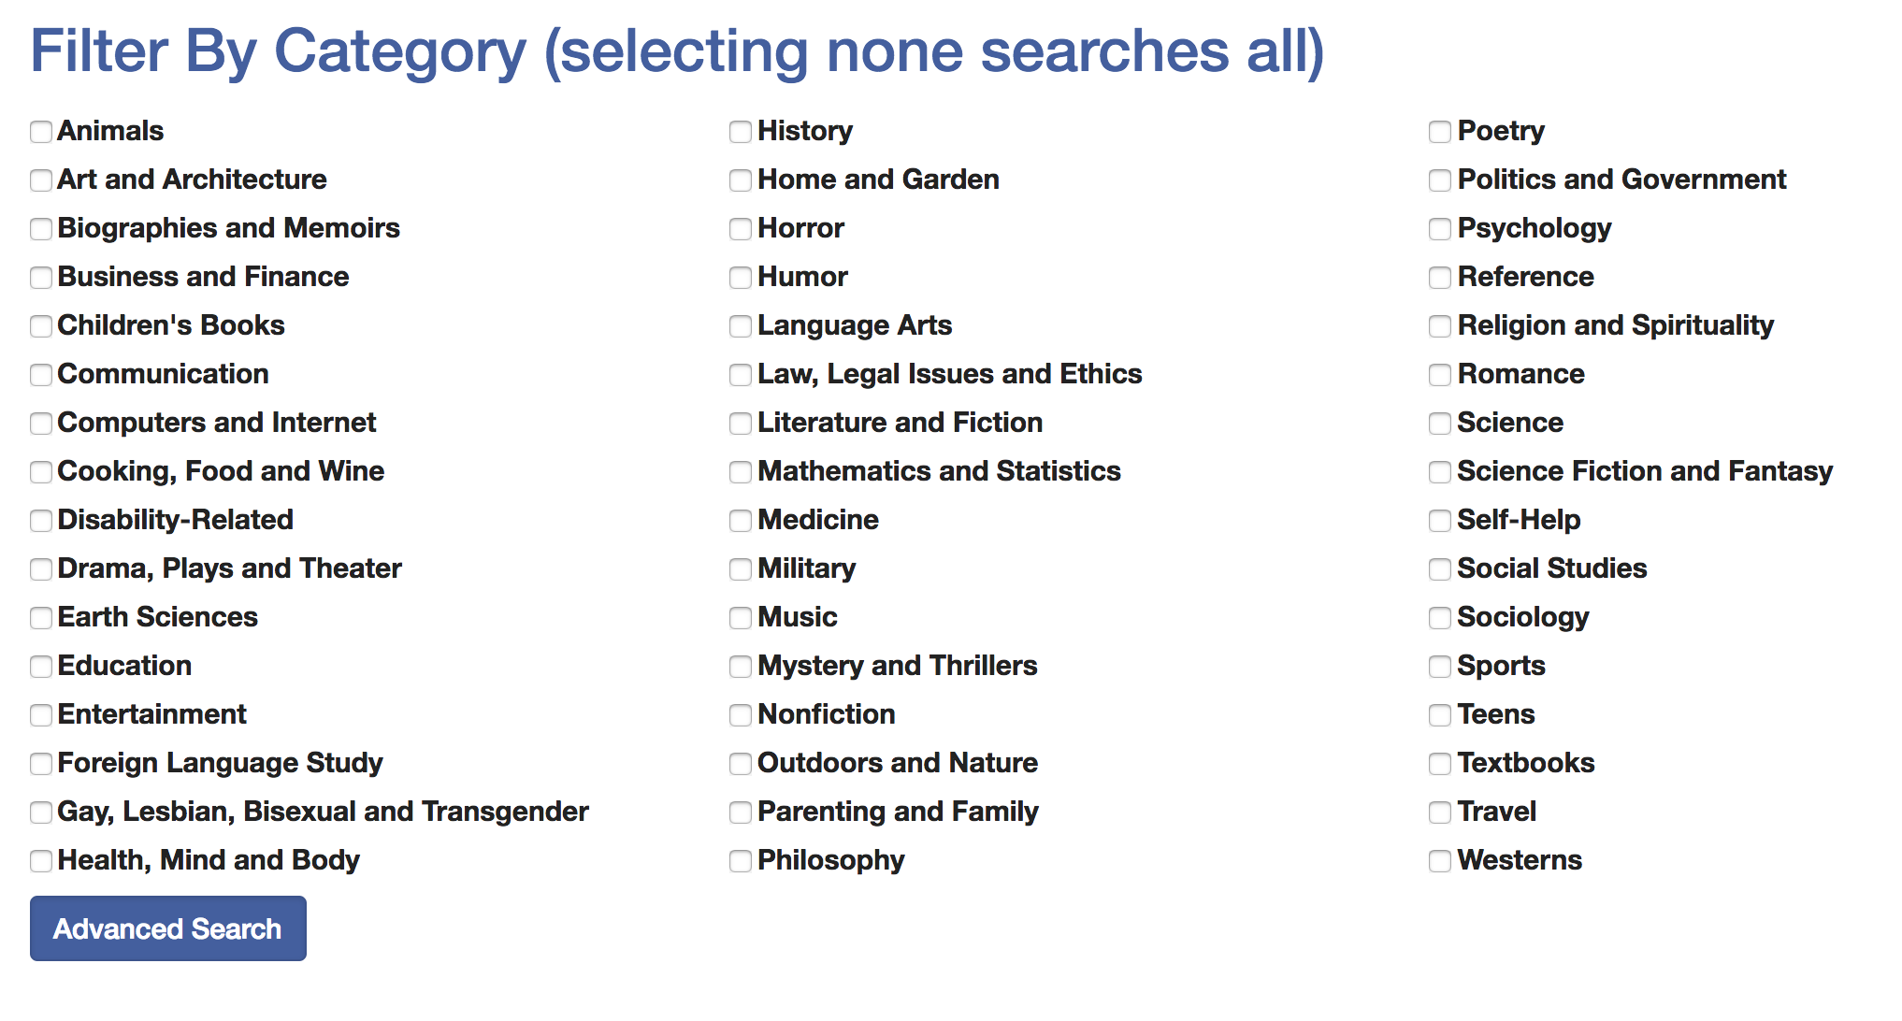
Search

Slide 12
Reading Options

Slide 13
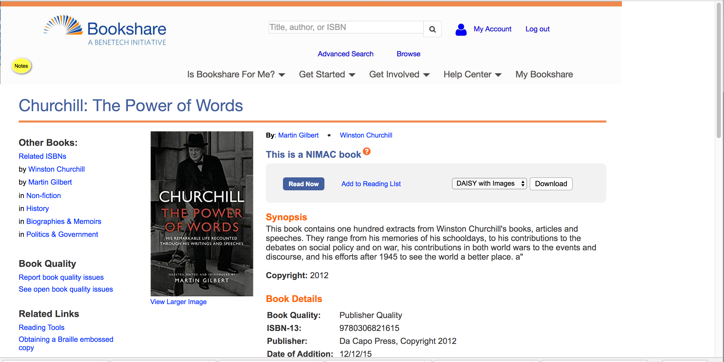

Slide 17
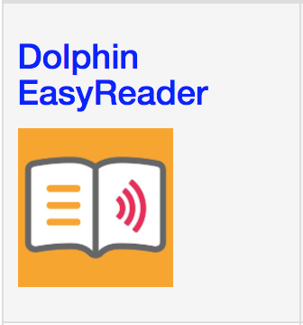
Mobile Reading Options
Notes:
“If the program is a screen reader like JAWS or NVDA it’ll read any text displayed on the screen, which Bookshare’s content can easily be displayed on the screen just like a website.
If the program is a specific reading tool used to open files, it just needs to open either DAISY, ePub, XML, HTML, or our very new Docx files to access Bookshare books”

Slide 18
Try it now

Slide 19
Select a book – Read Now

Slide 21
Push the button

Slide 23
24/7 Help and Support
Take advantage of online training and resources:
Help Center: bookshare.org/cms/help-center
Video Tutorials: https://www.bookshare.org/cms/help-center/training-and-resources/video-tutorials
Brochures and How-to Guides: https://www.bookshare.org/cms/help-center/training-and-resources/brochures
Connect with Bookshare on Facebook, Twitter, Pinterest, YouTube

Slide 24
Thank you.

