Slide 1
ASTM Compass
For EIFL

Slide 2
About ASTM
Organised in 1898 - American Society for Testing & Materials
One of the worlds largest standards developing organizations
Publish standards, specifications, test methods, books, journals, conference papers etc..
Training – classroom and online
Proficiency testing programs – 4,000+ laboratories take part worldwide
Funded mainly through income from sales
Close relationship with over 100 governments worldwide
Internationally recognized and accepted
HQ – Philadelphia, USA; 5 regional offices
(Washington, Brussels, Ottawa, Beijing & Mexico City)
Not for profit organisation

Slide 3


Helping Our World Work Better
30,000 Global Members – Experts in their respective fields
150 Countries Represented
145 Main Technical Committees
(2,000 subcommittees)
Over 90 industry sectors represented
13,000 International Standards
40% standards change per annum
6,500 standards Cited by 75 Nations
100 Memorandums of Understanding
Thousands of customers in almost every country
52% of customers outside the USA
  Enhancing Safety
  Building Confidence
  Improving Performance

Slide 4
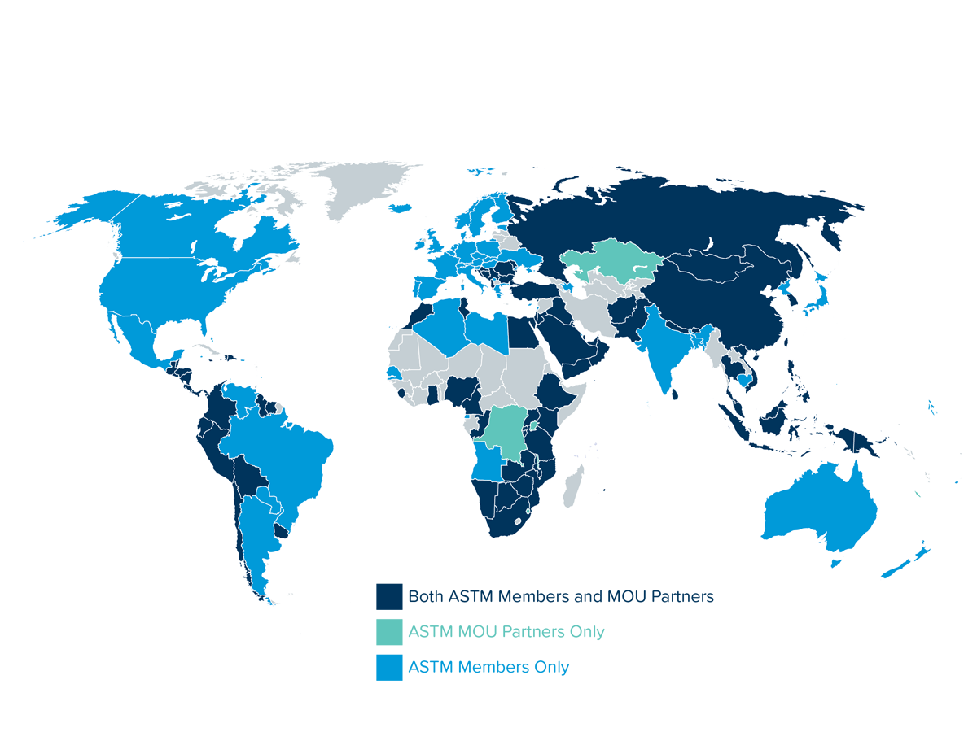
ASTM International Presence

Slide 5






Key Markets
Touching Every Part of Every Day Life
Aerospace, Defence and Space
Academia & Laboratory Testing
Energy
ASTM International Solutions
Construction
Government
Engineering & Manufacturing

Slide 6
















































Just a few ASTM Customers
Thousands Worldwide…..almost all Fortune 500 companies
Notes:
6

Slide 7
About ASTM
“Students with a knowledge and understanding of standards have a real advantage over those who don’t. Standards underpin most of the industry sectors they will be joining when they start their careers”
90% of worlds top 100 technical universities use ASTM Compass

Slide 8
ASTM Compass
Coverage (not exhaustive)
﻿Civil
Engineering
﻿Environmental
Engineering
﻿Chemical
Engineering
﻿Bio Medical
Engineering
﻿Aerospace
Engineering
﻿Geological
Engineering
ASTM Compass
﻿Petroleum
Engineering
﻿Health & Safety
Engineering
﻿Industrial
Engineering
﻿Materials
Science
Engineering
﻿Mechanical
Engineering
﻿Nuclear/Solar
Engineering

Slide 9
ASTM Compass
Standards
ASTM Standards
13,000 active standards
43% are globally recognized test methods
Version comparison
28,500 historical standards
1,000 withdrawn standards
Active standards in PDF/HTML
Notes:
9

Slide 10
ASTM Compass
Journals
16,800 Journal Papers, 120,000+ pages - Articles all peer reviewed
Name | Date | Pages
Advances in Civil Engineering Materials | 2012 to today | NEW Online Only
Materials Performance and Characterisation | 2012 to today | NEW Online Only
Geotechnical Testing Journal (GTJ) | 1978 to today. 6 per annum | 10,200 pages 150+ volumes
Journal of Testing and Evaluation (JTE) | 1973 to today. 6 per annum | 18,550 pages 235+ volumes
Abstracted/indexed: ISI Science Citation Index, COMPENDEX, Chemical Abstracts, Web of Science, Cambridge Scientific Abstracts, Materials Science Citation Index and more ……..
Notes:
10

Slide 11
ASTM Compass
Journals
Articles all peer reviewed
Name | Date | Pages
Journal of ASTM International (JAI) | 2004 to 2012 | 26,190 pages 90+ volumes
Journal of Cement, Concrete and Aggregates | 1979 to 2004 | 1,400 pages 50+ volumes
Journal of Composites Technology and Research (JCTR) | 1978 to 2003 | 4,500 pages 95+ volumes
Journal of Forensic Sciences (JOFS) | 1972 to 2005 | 56,200 pages 170+ volumes
Notes:
11

Slide 12
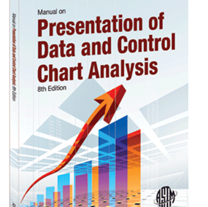
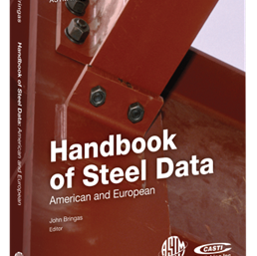
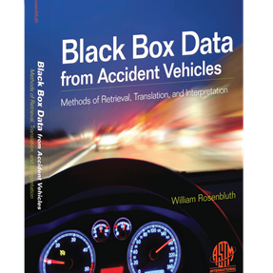
ASTM Compass
eBooks
eBooks
Selected Technical Papers (STP’s)
Manuals, Monographs & Data Series
Collectively over 1,600 eBooks
Selected Technical Papers (STPs)
Manuals, Monographs & Data Series
35,480 Symposium Papers & Chapters
The latest engineering research from ASTM
29,000 papers - all peer reviewed
1,500+ books and growing annually
407,000 pages
1931 – today
Practical, hands-on application information (manuals)
Highly technical information (monographs)
Written by highly-regarded experts
120+ books and growing annually
23,000+ pages
1965 – today

Slide 13
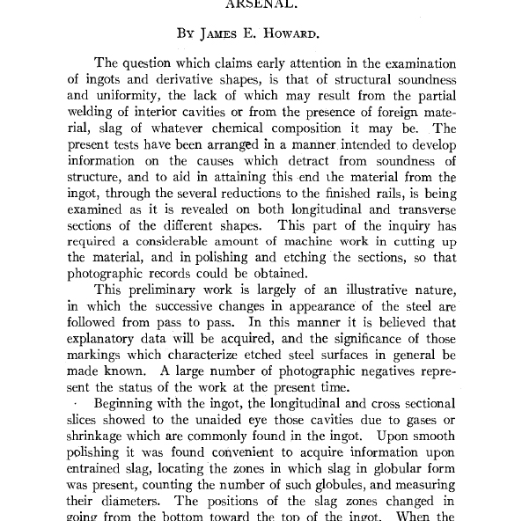
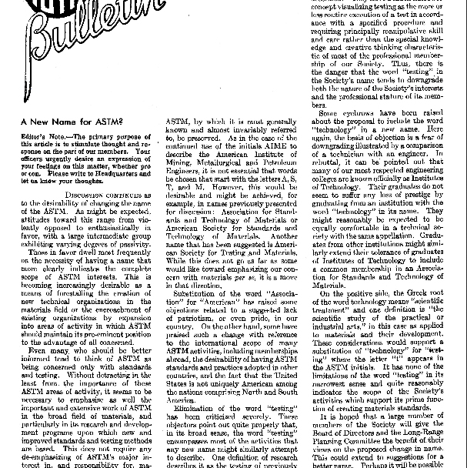
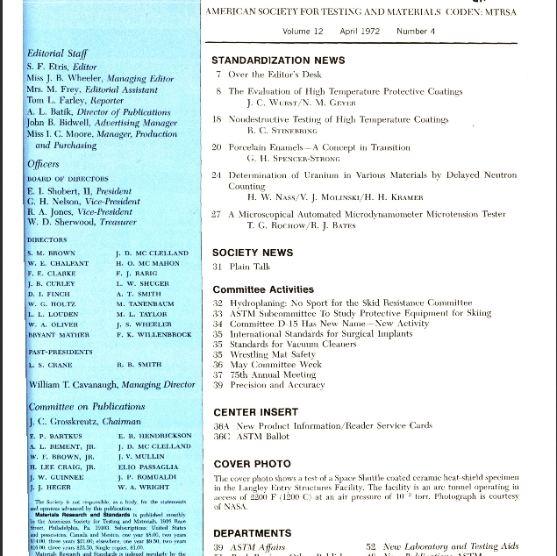
ASTM Compass
Proceedings, Bulletins, Materials Research & Standards
Proceedings
Bulletins
Materials Research & Standards
Published annually and include all committee reports and technical papers offered to ASTM during the calendar year. Digital copies are available from approximately 1909 - 1965
The official ASTM member magazine from 1921 to 1960. Published quarterly, these editions included news of the Society, its technical committee activities and publications, as well as technical papers. Each quarterly edition contains many individual technical papers
The official ASTM member magazine from 1961 to 1972. Published monthly, these editions included news of the Society, its technical committee activities and publications, as well as technical papers. Each monthly edition contains many individual technical papers

Slide 14



ASTM Compass:
Faculty applicability examples
Aerospace Engineering
Petroleum Engineering
Civil Engineering
References in title & abstract
Standards – over 400
eBooks – over 1,600
Journals – over 650
References in title & abstract
Standards – over 1,600
eBooks – over 2,300
Journals – over 500
References in title & abstract
Standards – over 3,600
eBooks – over 6.200
Journals – over 2,100

Slide 15

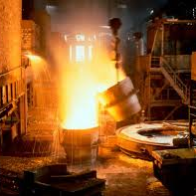

ASTM Compass:
Faculty applicability examples
Mechanical Engineering
Materials
Environment
References in title & abstract
Standards – over 4,700
eBooks – over 11,100
Journals – over 3,600
References in title & abstract
Standards – over 10,500
eBooks – over 24,600
Journals – over 8,300
References in title & abstract
Standards – over 2,500
eBooks – over 7,200
Journals – over 2,500

Slide 16
ASTM Compass: eBook Breakdown
ASTM Compass offers a comprehensive range of eBooks covering a wide range of engineering disciplines
29,000 papers: all peer reviewed! All symposia papers are published in book format (known as STPs or Selected Technical Papers). Download individual papers from any book or simply download the entire book itself
Get practical, hands-on application information (Manuals) or advanced and highly technical information (Monographs) from highly-regarded experts in their respective fields. The ASTM Data Series cover specific applications, contain compiled data, and usually include explanatory text.
140
Petroleum Products, Lubricants, and Fossil Fuels
442
Metals Test Methods and Analytical Procedures
345
Construction
ASTM eBooks
204
Water and Environmental Technology
78
Iron and Steel Products
85
General Methods and Instrumentation

Slide 17
ASTM Compass
No Restrictions
Use as many ASTM documents as you wish
No Restrictions
Unlimited simultaneous users. No-one will ever be blocked out – instant desk top access
Multi Lingual Searching
10 languages and more coming …
Always up to Date
Updated daily with new and updated information

Slide 18
ASTM Compass:
Flexible access for Academic Administrators & Librarians
Secure reliable platform
IP based or ASTM applet – no user names & passwords to remember
COUNTER compliant statistics
Customer support
MARC records
No concurrent user restrictions
No download restrictions
DOI reference linking via CrossRef, Summon etc..
"It's a no-brainer. ASTM publications are on the cutting edge. Full-stop, end-of-discussion and since these are peer-reviewed papers, that validates their utility“ – University User

Slide 19
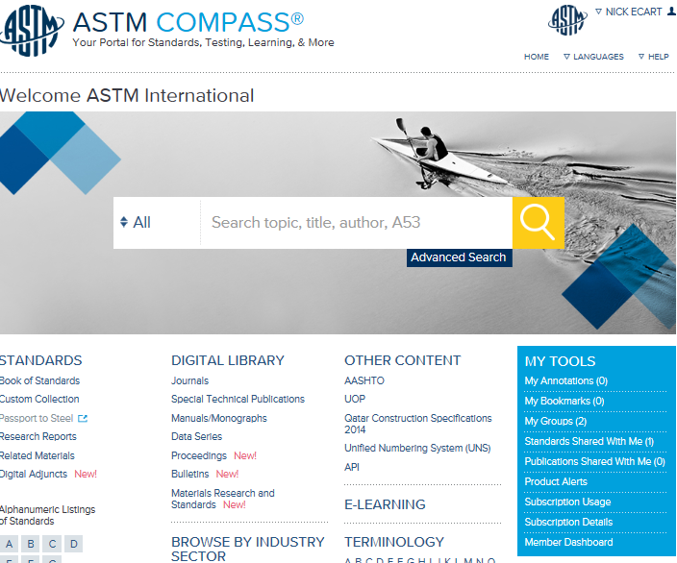
Welcome to ASTM Compass

Slide 20
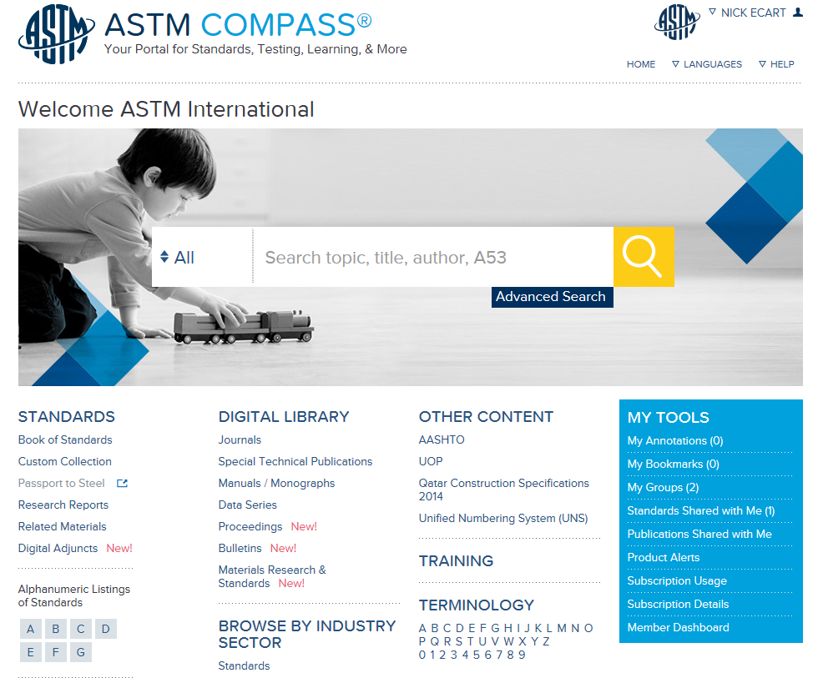
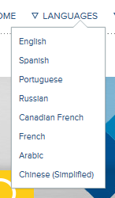
ASTM Compass Functionality
Interface in 10 languages… more languages coming

Slide 21
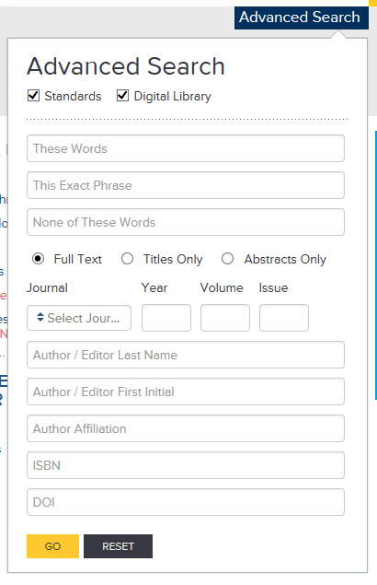
ASTM Compass Functionality
Simple or Advanced Searching

Slide 22
ASTM Compass Functionality
Tools

Slide 23
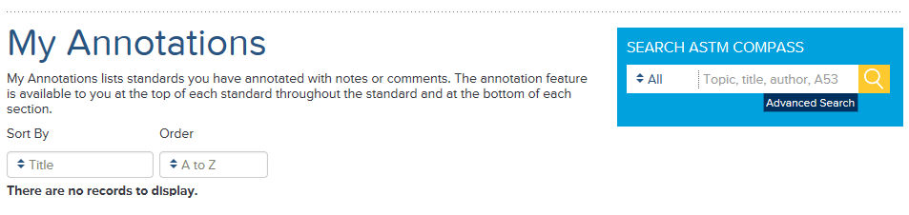
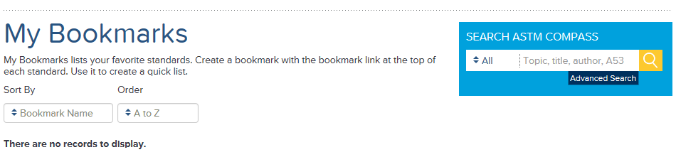
ASTM Compass Functionality
Annotations & Bookmarks

Slide 24
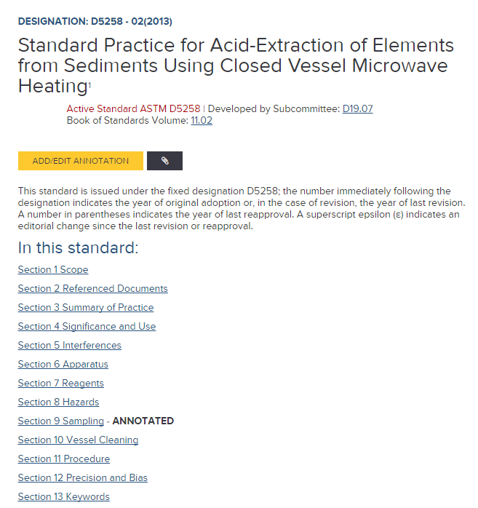
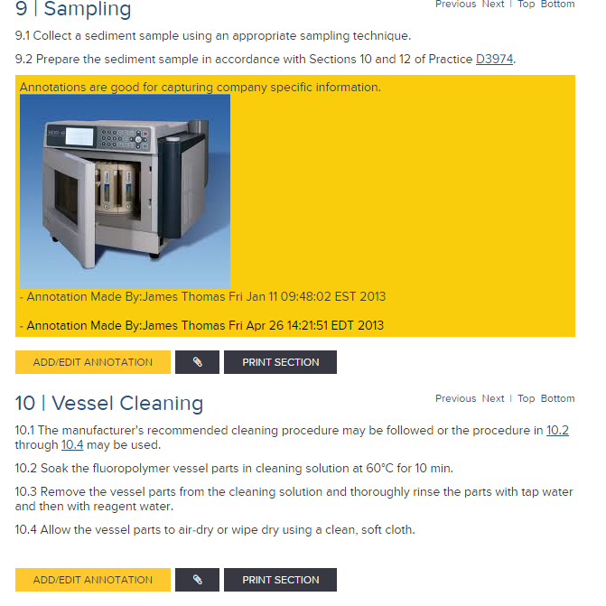
ASTM Compass Functionality
Annotations example

Slide 25
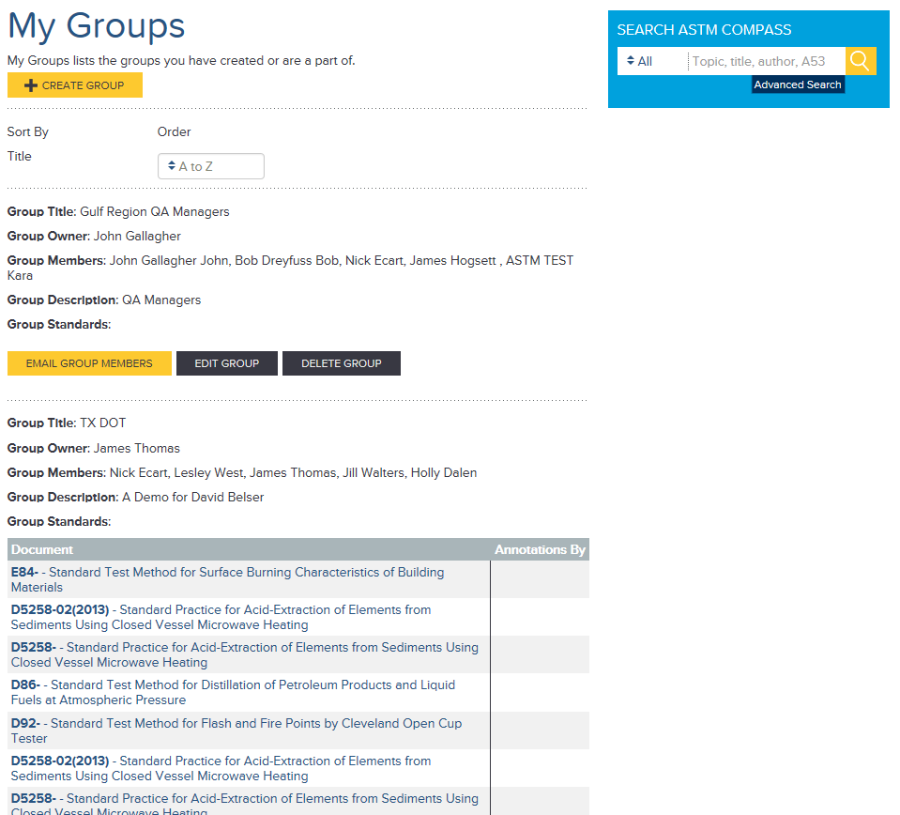
ASTM Compass Functionality
Create a Group & Share Standards

Slide 26
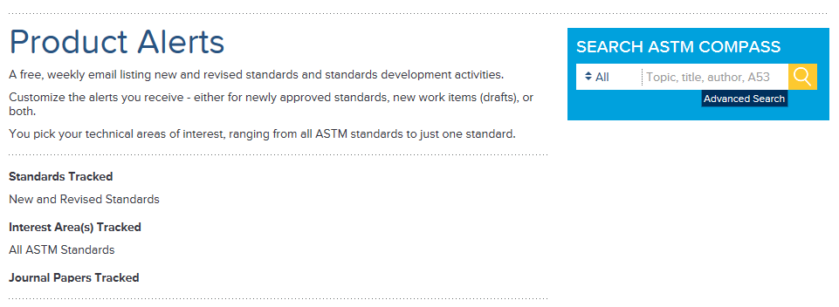
ASTM Compass Functionality
Product Alerts – keep up to date with new/amended standards

Slide 27
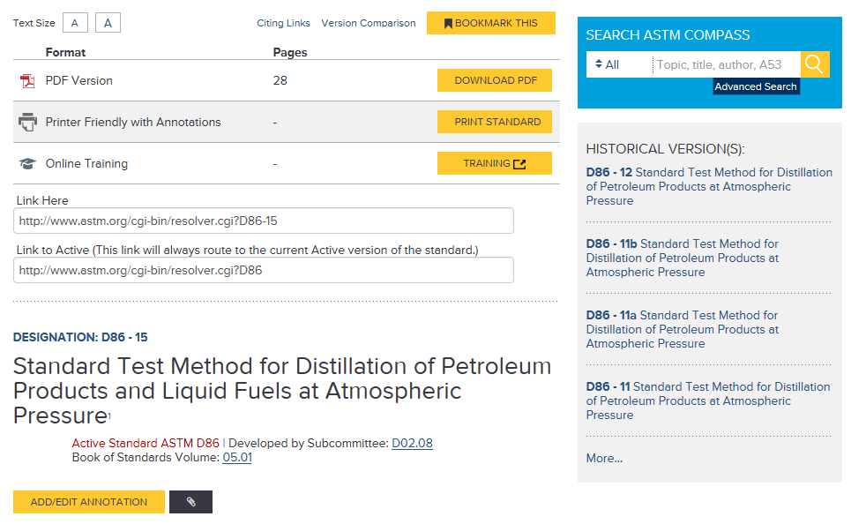
ASTM Compass Functionality
Typical Standards Record – extremely detailed; direct from source

Slide 28
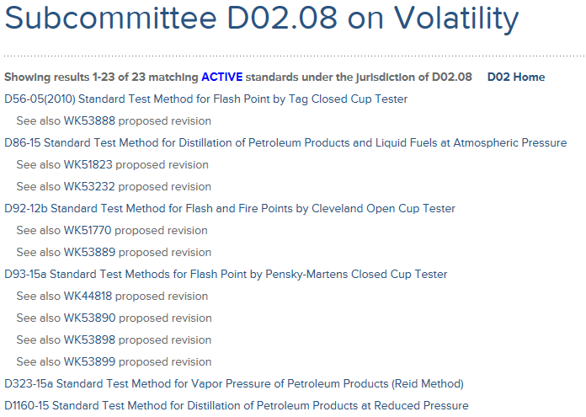
ASTM Compass Functionality
Direct Links to ASTM Experts & Technical Committees

Slide 29
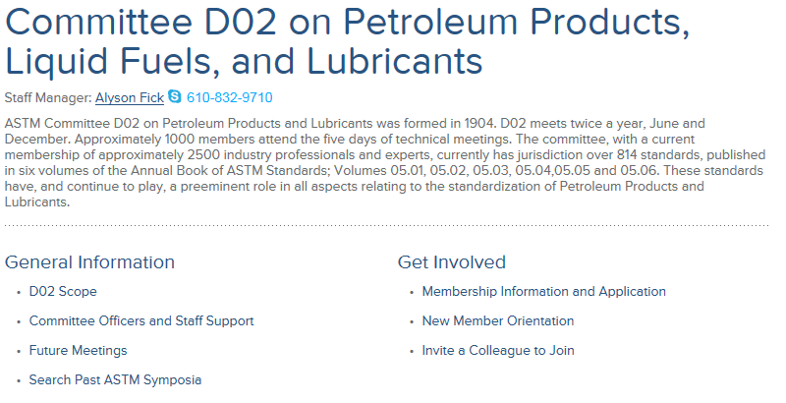
ASTM Compass Functionality
Direct Links to ASTM Experts & Technical Committees

Slide 30
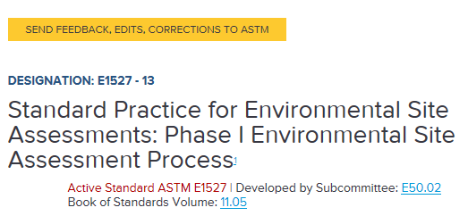
ASTM Compass Functionality
Direct Links to ASTM Experts & Technical Committees

Slide 31
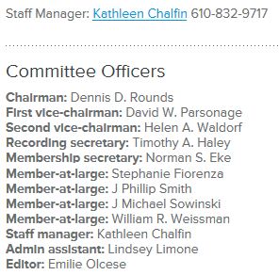
ASTM Compass Functionality
Direct Links to ASTM Experts & Technical Committees

Slide 32
ASTM Compass Functionality
See proposed revisions

Slide 33
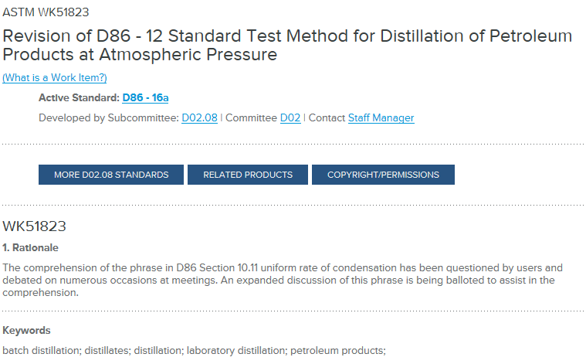
ASTM Compass Functionality
See proposed revisions

Slide 34
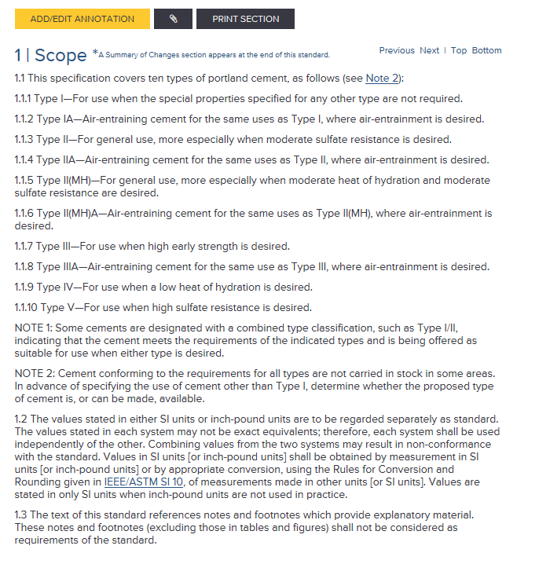
ASTM Compass Functionality
HMTL Versions of Standards – flexible text based content (or PDF)

Slide 35

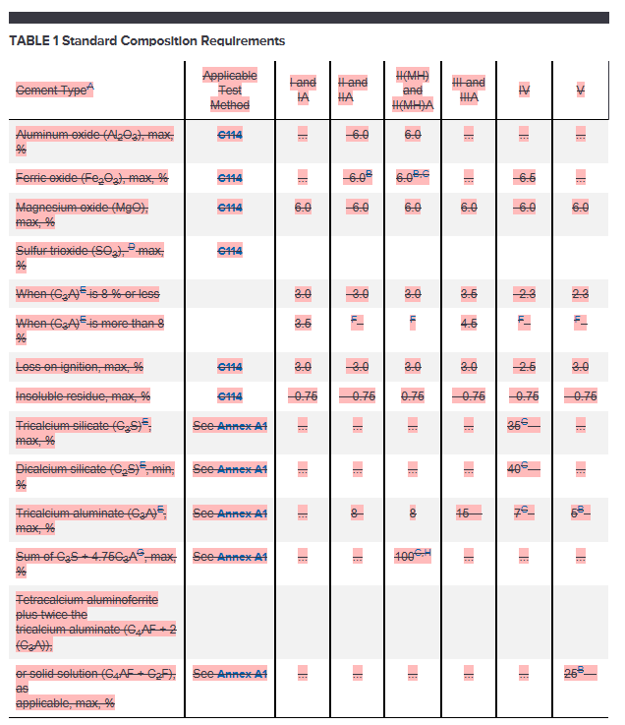
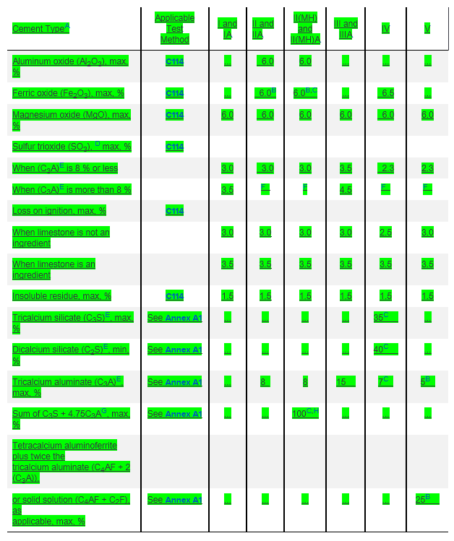
ASTM Compass Functionality
Version Comparison – saves hours of work

Slide 36
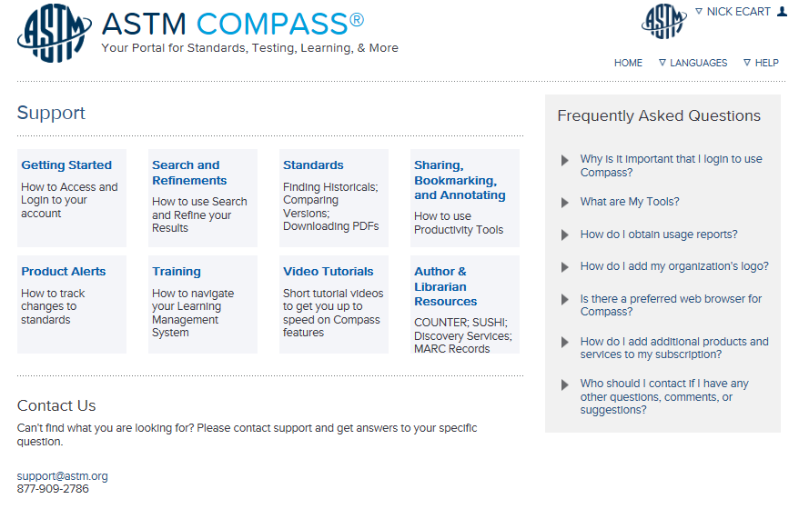
ASTM Compass Help
Explanations, Videos & FAQs

Slide 37
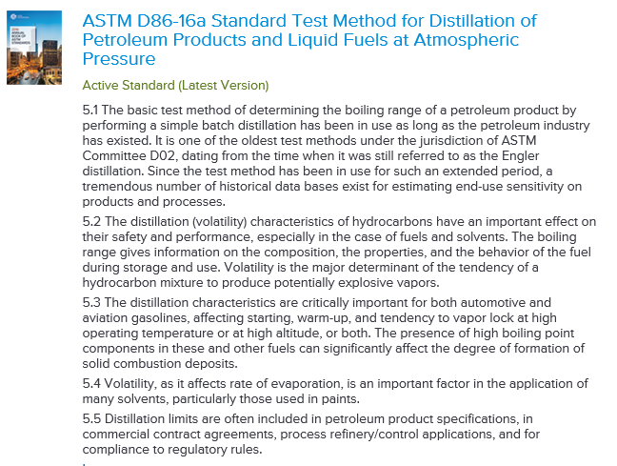
ASTM Compass for EIFL
Abstract Version
A typical ASTM standard abstract

Slide 38
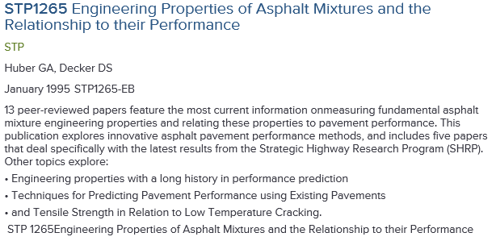
ASTM Compass for EIFL
Abstract Version
A typical ASTM book abstract

Slide 39
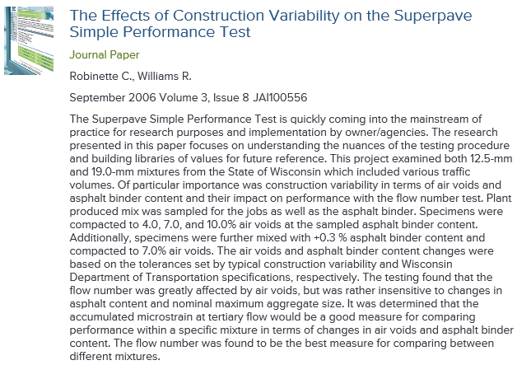
ASTM Compass for EIFL
Abstract Version
A typical ASTM journal abstract

Slide 40
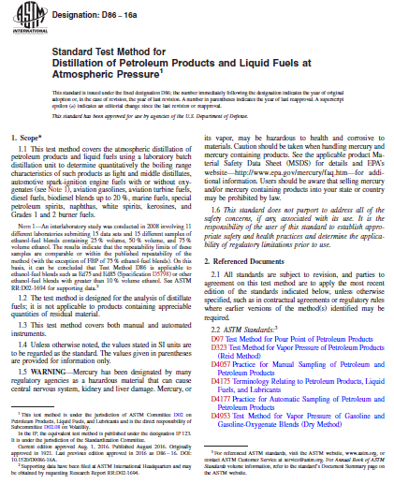
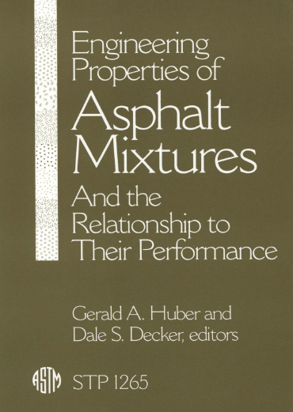
ASTM Compass for EIFL
Full text version

Slide 41
ASTM Compass for EIFL
ASTM Compass Abstract | ASTM Compass Full Text
- Abstracts for all ASTM publications | As per Abstract option + view, download & print all full text documents of all ASTM publications
- 13,000 standards
- 8 journals
- 1,800 eBooks
- proceedings & bulletins
- Full text searching
- Product alerts
- Interface in 10 languages

Slide 42
Thank you
Nick Ecart - necart@astm.org | +44 793 2103758

